Slide 1
PREDICTING STUDENT SUCCESS: A CASE STUDY BASED ON THE TRANSCRIPT AND PERSONAL DATA OF THE GRADUATED STUDENTS AT COMPUTER ENGINEERING DEPARTMENT, ATILIM UNIVERSITY, TURKEY
Author : Ulaş Ozan CEYHAN Supervisor : Assoc. Prof. Murat Karakaya
28.01.2019

Slide 2
Content
Motivation
Aim of Study
Processes of Study
Raw Data
Data pre-processing
Student Success Metrics
Data Input Sets
Selected Machine Learning Algorithms
Performance Metrics
Results
Discussion, Conclusion, Findings
Future Work

Slide 3
Motivation
Financial and time loss
Lower graduation rates
School reputation
Dropout and withdrawal rates
Notes:
In higher institutions such as universities and colleges, the aims are becoming increas-
ingly significant using educational data for higher quality. The main reason behind
this intend is preventing financial and time loss. Educational Data Mining (EDM)
and Learning Analytic (LA) play more important role on such losses. For this rea-
son, predicting student situation, analyzing students’ performances are as important
as ever. Even, predicting the performances of students is critical for higher institu-
tions [1]. Because, student performance means the dropout and withdrawal rates and
students who have high failure potentials. These factors result in financial loss, lower
graduation rates and school reputation

Slide 4
Aim of Study
Predicting the student success in the selected courses considering their transcript and personal data.
Analyzing the result of predicting course success.

Slide 5

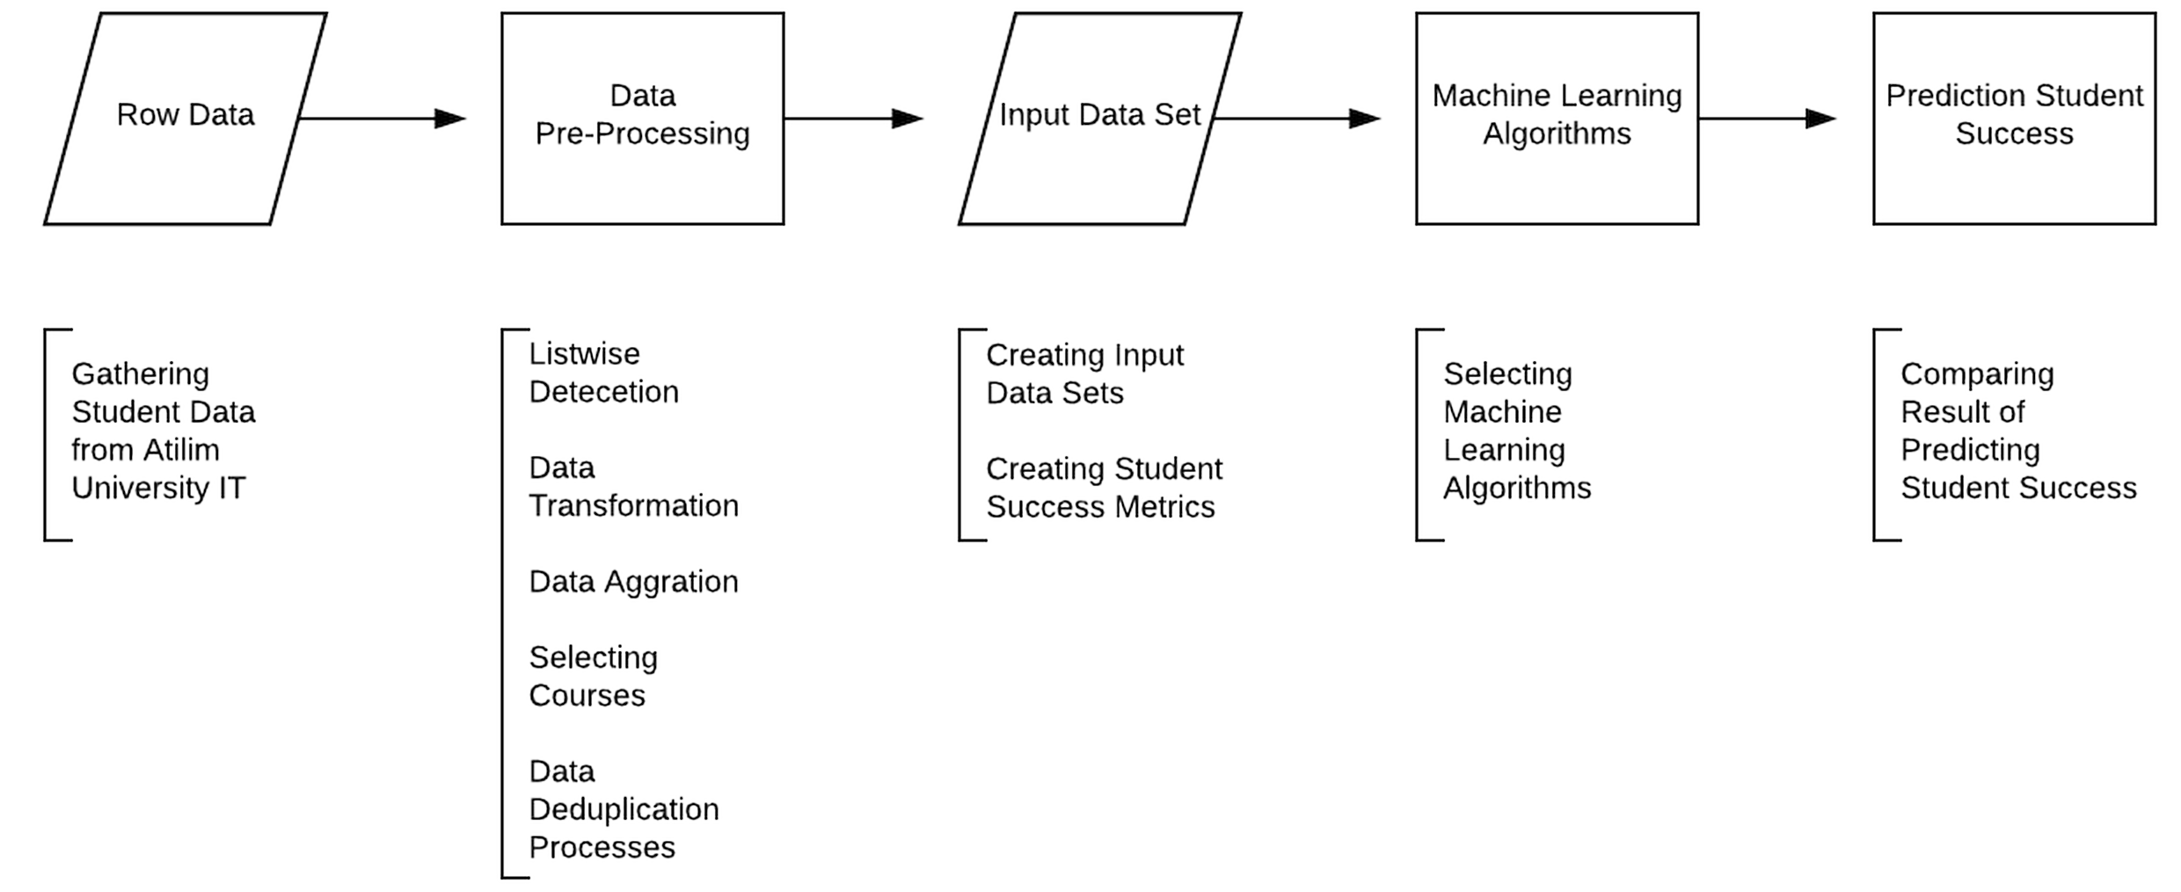
Processes of Study

Slide 6
Raw Data
266 students
Students, semesters and courses data sets
Vertical, horizontal transfer and Erasmus program students
Must Courses
Computer Engineering

Slide 7
Data Pre-processing
Listwise Deletion
Any instance in a data set is deleted from an analysis if they are missing data.
Some students who were in exempt, horizontal, vertical transfer or Erasmus Exchange Program situations are removed.
Data Aggregation
Data aggregation is a process to generate new summarized format from raw data.
We applied the data aggregation methods in order to show only one table from the previously three tables of Courses, Semesters and Students.
Notes:
This method is utilized when missing values are emerged throughout the data. In order
to avoid such missing values, these rows must be removed from the data.
In this study, we applied the data aggregation methods in order to show only one table
from the previously three tables of Courses, Semesters and Students.

Slide 8
Data Pre-processing
Data Deduplication
Data Deduplication is used for eliminating duplicate copies of data
We applied this processes on courses tables for the current curriculum of Computer Engineering Department of Atilim University.
The curriculum has been changed over the years.
We replaced old courses names to their current names.
Notes:
Data Deduplication is used for eliminating duplicate copies of data.
We applied this
processes on courses tables for the current curriculum of Computer Engineering De-
partment of Atilim University.

Slide 9
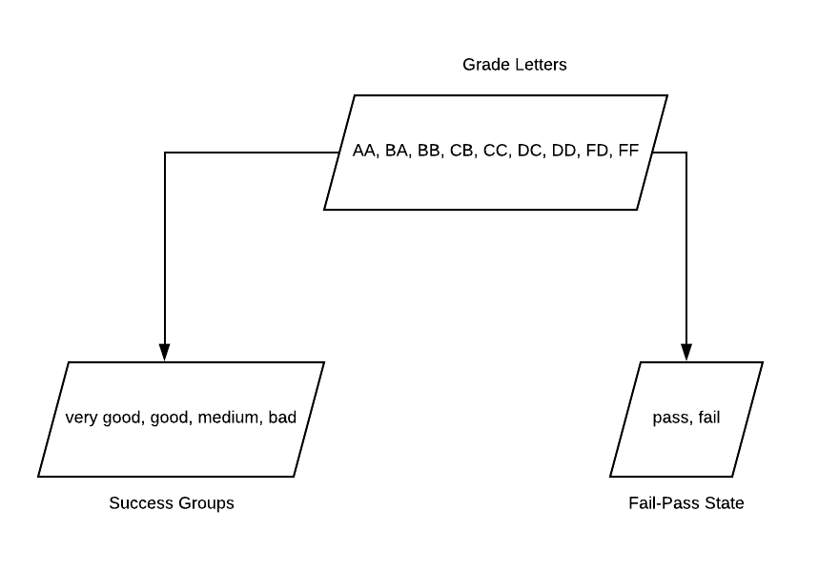
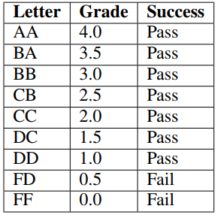
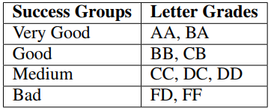
Student Success
Metrics
Grade Letters
Success Groups
Fail-Pass State
<number> of 42
Notes:
The final metric is the Fail-Pass State. In universities, Fail-Pass State specifies that
whether a student acquires the learning outcomes from the courses or not.

Slide 10
Data Input Sets
All Courses Taken Before the Target Semester
This set specifies all courses which are taken between the Target Semester and second semester
All Courses Taken in The Semester Prior to Target Semester
It means the previous semester just before the target semester.
Courses Selected by a Feature Selection
Another set is created by using Feature Selection Algorithm in order to select the courses.
Personal Data of Students
Grade Point Average (GPA), Cumulative Grade Point Average (CGPA), gender, credits, the number of taken courses in a semester (NTC) are considered in this set.

Slide 11


Selected Machine Learning Algorithms
Naïve Bayes
Multilayer Perceptron
SMO
J48
AdaBoostM1

Slide 12
Naïve Bayes
It uses probabilistic relationships among the predictors
Independent data
Training data are large or moderate

Slide 13
Student | MATH151 | MATH152 | MATH276
S1 | pass | fail | pass
S2 | fail | fail | fail
S3 | pass | pass | pass
S4 | fail | pass | pass
MATH152 | passed | failed
pass | 2/3 | 0/1
fail | 1/3 | 1/1
MATH151 | passed | failed
pass | 2/3 | 0/1
fail | 1/3 | 1/1
Student | MATH151 | MATH152 | MATH276
S5 | fail | pass | ?

Slide 14
Naïve Bayes
Pass
1/3*2/3=2/9
Fail
1/1*0/1=0
Therefore, the student pass the MATH276 course

Slide 15
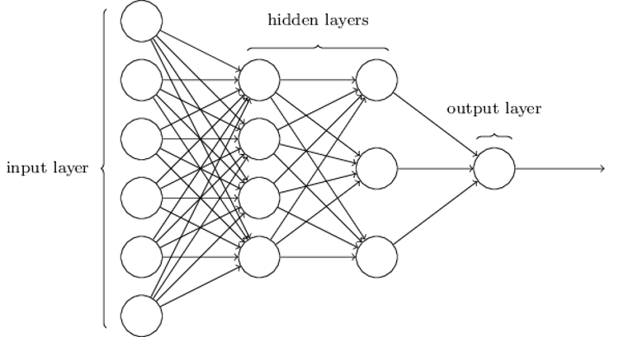
Multilayer Perceptron
Neural network algorithm
Back-propagation algorithm
Multilayer feed-forward process
Weight is updated with respect to the total error
Non-linear boundaries
Notes:
The Multilayer Perceptron is one of the Neural Network Algorithms which uses the back-propagation algorithm to predict instances. The algorithm behaves based on a multilayer feed-forward process in which the learning grows up with a set of weights
The attributes, which are represented course names in this study, get the weights are initialized randomly. In the end, the total error is compared to the desired output.
Then, the weight is updated with respect to the total error. It is used when there exist non-linear boundaries between the attributes representing the grades of the courses

Slide 16
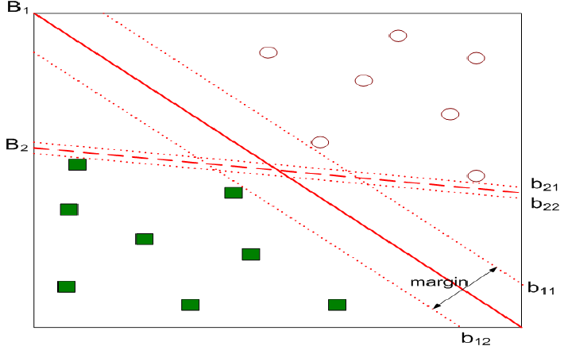
Sequential Minimal Optimization (SMO)
Implements John Platt's sequential minimal optimization algorithm for training a support vector classifier.
SMO algorithm creates two categories and provides the new instance to enter one of them.
In each step, it optimizes the objective value of the two categories.
When new instance comes the algorithm decides which category is more optimal for the updated objective value
Notes:
SMO algorithm is a kind of Support Vector Machines algorithm.
SMO algorithm creates two categories and provides the new instance to enter one of them.
In each step, it optimizes the objective value of the two categories. When new instance comes, the algorithm decides which category is more optimal for the updated objective value
This algorithm gives a
high performance when speed is necessary.

Slide 17
J48
It uses C4.5 decision tree algorithm
It finds the normalized information gain ratio
It gets the best attribute with the highest normalized information gain.
It creates a decision node that splits on the best attribute
Notes:
J48 algorithm depends on the J.R. Quilan C4.5 decision tree algorithm [33].
In respect of training data, J48 algorithm, whose parameters are presented in Table 5.2, predicts the new data after dividing into nodes [34].
The possible outcomes are defined after
selecting a decision in this algorithm

Slide 18
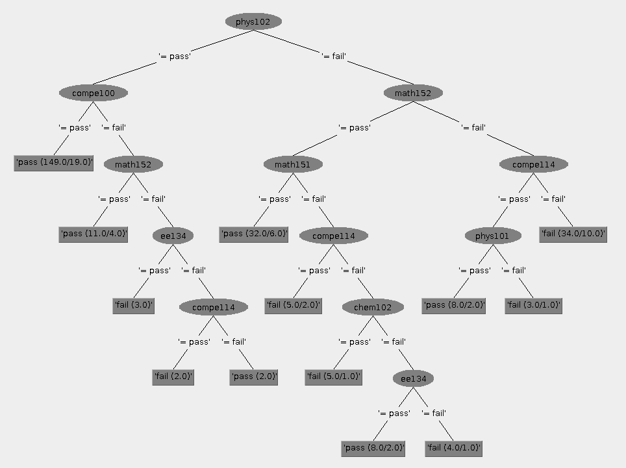
COMPE231

Slide 19
AdaBoostM1
The weak or base learning algorithm
The result is generated after combining the predicted outputs given by the weak or base algorithm
In each iteration the weights are updated based on error rate
Notes:
Boosting is another method to improve the performance of predicting [31].
AdaboostM1 predicts the instance by calling other learning algorithms, namely the weak or base learning algorithm, to give better results.
For example, in Table 5.5, the Decision Stump which is a one level decision tree [35], is selected as a weak algorithm.
In the end, the result is generated after combining the predicted outputs given by the weak or base algorithm [36]. In each iteration the weights are updated based on error rate [31].

Slide 20
Performance Metrics
Accuracy
Precision
Recall
ROC (Receiver Operating Characteristic) Area

Slide 21
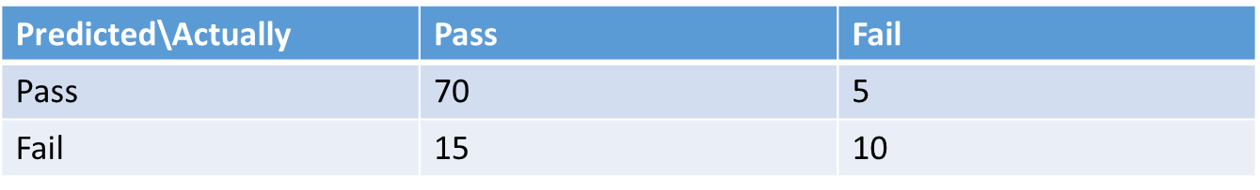
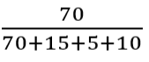
Accuracy (A)
The percentage of correctly predicted instances.
Eg. 100 students of Fail Pass State in COMPE431
Accuracy =

Slide 22
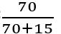
Recall (R)
The total number of grade instances correctly predicted in all instances of student success metric that must be predicted.
Eg. 100 students of Fail Pass State in COMPE431
Recall=
Weighted recall
Notes:
Recall tells you how many of the objects that should have been selected were actually selected

Slide 23
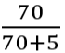
Precision (P)
The total number of instances that are correctly predicted in all predicted instances of students success metric.
Eg. 100 students of Fail Pass State in COMPE431
Precision =
Weighted Precision
Notes:
Now, precision tells you how many of the selected objects were correct.

Slide 24
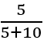
ROC Area (Receiver Operating Characteristic)
The degree or measure of separable of success metrics and it provides the capability of the predicted student success metrics to be differentiated between metrics
True Positive Rate (TPR) and False Positive Rate (FPR) at various threshold settings. TPR is same as Recall calculation.
FPR =
Notes:
An ROC curve (receiver operating characteristic curve) is a graph showing the performance of a classification model at all classification thresholds. This curve plots two parameters:

Slide 25
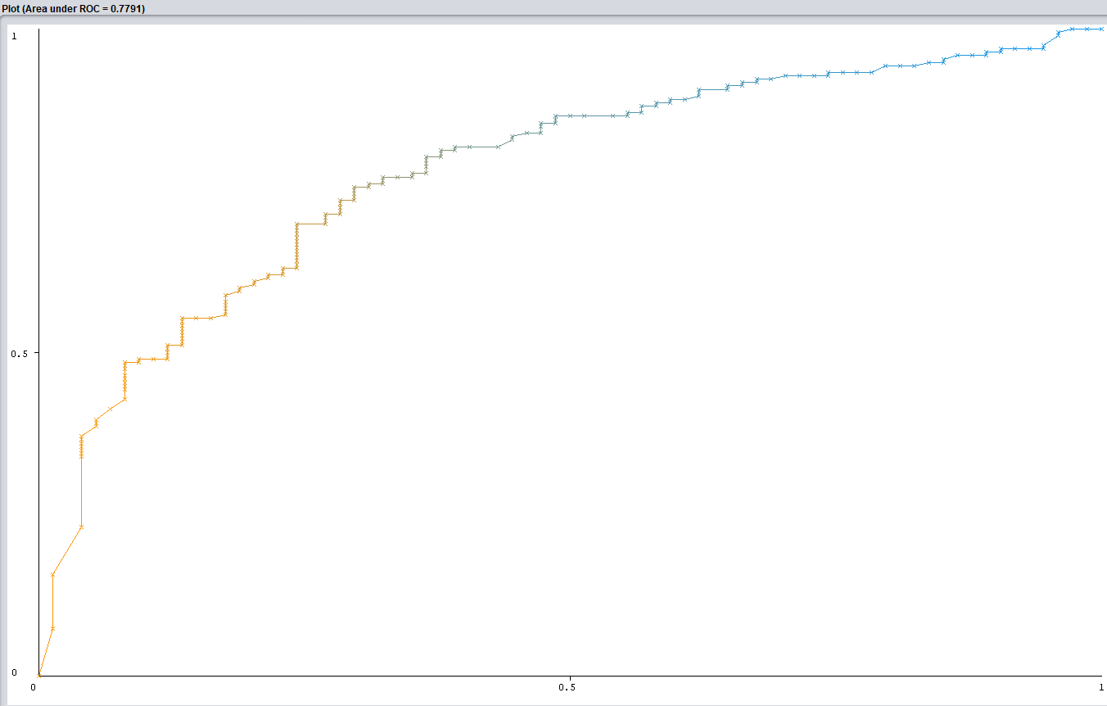
ROC Area
Eg. COMPE 231, class: pass, ROC Area: 0.7791

Slide 26
Results
Accuracy, weighted recall, weighted precision of prediction success based on Input Data Sets are presented.
Each table includes all courses.
The maximum accuracy for each algorithm are labeled in red.
The highest percentage of each red percentage is bold.

Slide 27
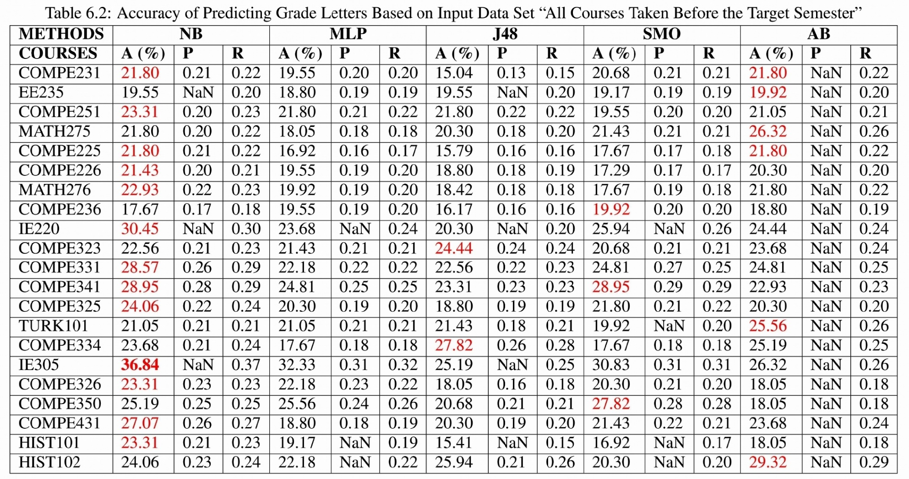
Accuracy, Weighted Precision and Weighted Recall of Predicting Target Course’s Grade Letters Based on Input Data Set “All Courses Taken Before the Target Semester”
Notes:
The results show that the accuracy of prediction success are between 15.04 (course name: COMPE231, algorithm: J48, precision: 0.13, recall: 0.15) and 36.84 (course name: IE305, algorithm: Naive Bayes, precision: NaN recall: 0.37).
The most successful algorithm is Naive Bayes. AdaBoostM1 comes second, and Multilayer Perceptron and J48 have lower highest values. Therefore, MP and J48 give poor performance on predicting course grade letters.
IE305 has the most successful percentage accuracy which is 36.84.
In courses, we observe that the three best prediction success of courses are IE305, IE220, and COMPE341, whereas the other course’s percentage accuracy is between 20-30%. Precision of AdaBoostM1 algorithm stays NaN value. This happens because the algorithm does not predict one of grade letters therefore weighted precision value cannot be calculated. Most of the precision and recall values of results are between 0.2-0.3.
<number>

Slide 28
Accuracy, Weighted Precision and Weighted Recall of Predicting Target Course’s Grade Letters Based on Input Data Set “All Courses Taken Before the Target Semester”
Notes:
The results show that the accuracy of prediction success are between 15.04 (course name: COMPE231, algorithm: J48, precision: 0.13, recall: 0.15) and 36.84 (course name: IE305, algorithm: Naive Bayes, precision: NaN recall: 0.37).
The most successful algorithm is Naive Bayes. AdaBoostM1 comes second, and Multilayer Perceptron and J48 have lower highest values. Therefore, MP and J48 give poor performance on predicting course grade letters.
IE305 has the most successful percentage accuracy which is 36.84.
In courses, we observe that the three best prediction success of courses are IE305, IE220, and COMPE341, whereas the other course’s percentage accuracy is between 20-30%. Precision of AdaBoostM1 algorithm stays NaN value. This happens because the algorithm does not predict one of grade letters therefore weighted precision value cannot be calculated. Most of the precision and recall values of results are between 0.2-0.3.
<number>

Slide 29
Accuracy, Weighted Precision and Weighted Recall of Predicting Target Course’s Grade Letters Based on Input Data Set “All Courses Taken Before the Target Semester”
Best A (%) Solution provided by NB
IE305 gives the best A (%)
Notes:
The results show that the accuracy of prediction success are between 15.04 (course name: COMPE231, algorithm: J48, precision: 0.13, recall: 0.15) and 36.84 (course name: IE305, algorithm: Naive Bayes, precision: NaN recall: 0.37).
The most successful algorithm is Naive Bayes. AdaBoostM1 comes second, and Multilayer Perceptron and J48 have lower highest values. Therefore, MP and J48 give poor performance on predicting course grade letters.
IE305 has the most successful percentage accuracy which is 36.84.
In courses, we observe that the three best prediction success of courses are IE305, IE220, and COMPE341, whereas the other course’s percentage accuracy is between 20-30%. Precision of AdaBoostM1 algorithm stays NaN value. This happens because the algorithm does not predict one of grade letters therefore weighted precision value cannot be calculated. Most of the precision and recall values of results are between 0.2-0.3.
<number>

Slide 30
Accuracy, Weighted Precision and Weighted Recall of Predicting Target Course’s Grade Letters Based on Input Data Set “All Courses Taken Before the Target Semester”
NaN values are existed, because one of Grade Letters is not predicted by the algorithm. Therefore, divisor of precision is zero and it gives an error while the calculation.
Notes:
The results show that the accuracy of prediction success are between 15.04 (course name: COMPE231, algorithm: J48, precision: 0.13, recall: 0.15) and 36.84 (course name: IE305, algorithm: Naive Bayes, precision: NaN recall: 0.37).
The most successful algorithm is Naive Bayes. AdaBoostM1 comes second, and Multilayer Perceptron and J48 have lower highest values. Therefore, MP and J48 give poor performance on predicting course grade letters.
IE305 has the most successful percentage accuracy which is 36.84.
In courses, we observe that the three best prediction success of courses are IE305, IE220, and COMPE341, whereas the other course’s percentage accuracy is between 20-30%. Precision of AdaBoostM1 algorithm stays NaN value. This happens because the algorithm does not predict one of grade letters therefore weighted precision value cannot be calculated. Most of the precision and recall values of results are between 0.2-0.3.
<number>

Slide 31
Accuracy, Weighted Precision and Weighted Recall of Predicting Target Course’s Grade Letters Based on Input Data Set “All Courses Taken Before the Target Semester”
The lowest A (%) provided by MLP
Notes:
The results show that the accuracy of prediction success are between 15.04 (course name: COMPE231, algorithm: J48, precision: 0.13, recall: 0.15) and 36.84 (course name: IE305, algorithm: Naive Bayes, precision: NaN recall: 0.37).
The most successful algorithm is Naive Bayes. AdaBoostM1 comes second, and Multilayer Perceptron and J48 have lower highest values. Therefore, MP and J48 give poor performance on predicting course grade letters.
IE305 has the most successful percentage accuracy which is 36.84.
In courses, we observe that the three best prediction success of courses are IE305, IE220, and COMPE341, whereas the other course’s percentage accuracy is between 20-30%. Precision of AdaBoostM1 algorithm stays NaN value. This happens because the algorithm does not predict one of grade letters therefore weighted precision value cannot be calculated. Most of the precision and recall values of results are between 0.2-0.3.
<number>

Slide 32
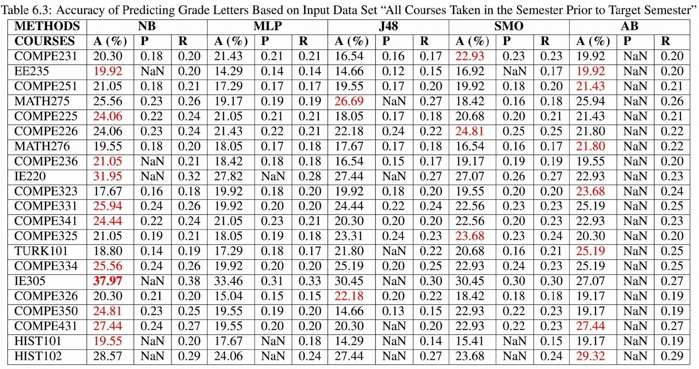
Accuracy, Weighted Precision and Weighted Recall of Predicting Target Course’s Grade Letters Based on Input Data Set “All Courses Taken in the Semester Prior to Target Semester”
Notes:
The result of percentage of correctly classified grade letters that are applied feature selection data set shows that the values vary between 14.29 (course name: HIST101, algorithm: J48, precision: NaN, recall: 0.14; course name: EE235, algorithm: J48, precision: 0.12, recall: 0.15) and 37.97 (IE305, Naive Bayes) as illustrated in Table 6.3.
It can be observed from results that the most successful algorithms giving the highest prediction success are Naive Bayes and AdaBoostM1. The results are similar with grade letter results in accordance with prediction success. The precision and recall values of algorithm prediction results are low.
NaN value means that one of grades is not in the predicted set, so the corresponding weighted precision value cannot be calculated
<number>

Slide 33
Accuracy, Weighted Precision and Weighted Recall of Predicting Target Course’s Grade Letters Based on Input Data Set “All Courses Taken in the Semester Prior to Target Semester”
<number> of 42
Notes:
The result of percentage of correctly classified grade letters that are applied feature selection data set shows that the values vary between 14.29 (course name: HIST101, algorithm: J48, precision: NaN, recall: 0.14; course name: EE235, algorithm: J48, precision: 0.12, recall: 0.15) and 37.97 (IE305, Naive Bayes) as illustrated in Table 6.3.
It can be observed from results that the most successful algorithms giving the highest prediction success are Naive Bayes and AdaBoostM1. The results are similar with grade letter results in accordance with prediction success. The precision and recall values of algorithm prediction results are low.
NaN value means that one of grades is not in the predicted set, so the corresponding weighted precision value cannot be calculated
<number>

Slide 34
Accuracy, Weighted Precision and Weighted Recall of Predicting Target Course’s Grade Letters Based on Input Data Set “All Courses Taken in the Semester Prior to Target Semester”
Notes:
The result of percentage of correctly classified grade letters that are applied feature selection data set shows that the values vary between 14.29 (course name: HIST101, algorithm: J48, precision: NaN, recall: 0.14; course name: EE235, algorithm: J48, precision: 0.12, recall: 0.15) and 37.97 (IE305, Naive Bayes) as illustrated in Table 6.3.
It can be observed from results that the most successful algorithms giving the highest prediction success are Naive Bayes and AdaBoostM1. The results are similar with grade letter results in accordance with prediction success. The precision and recall values of algorithm prediction results are low.
NaN value means that one of grades is not in the predicted set, so the corresponding weighted precision value cannot be calculated
<number>

Slide 35
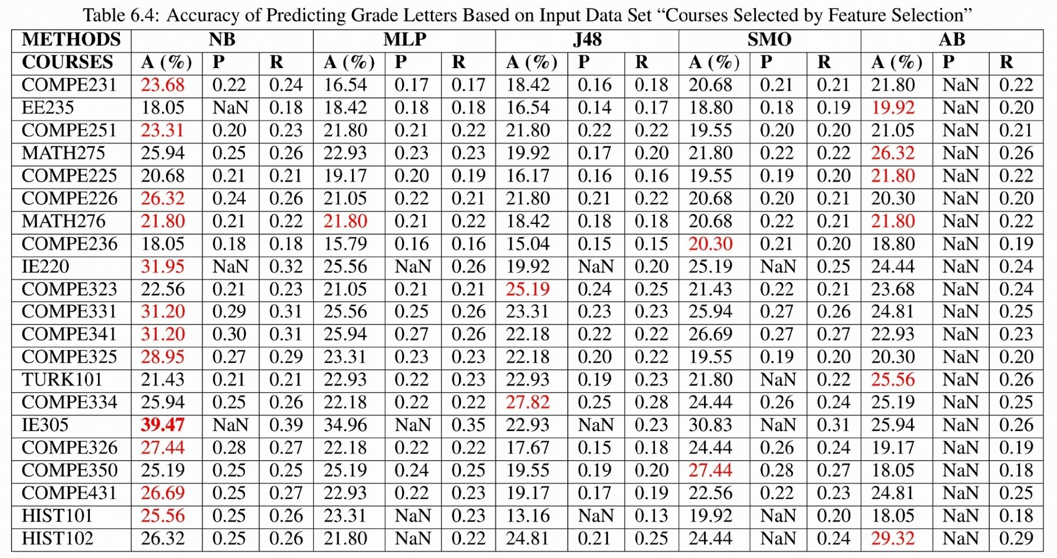
Accuracy, Weighted Precision and Weighted Recall of Predicting Target Course’s Grade Letters Based on Input Data Set “Courses Selected by a Feature Selection”
Notes:
As presented in Table 6.4, the results show that the values are between 13.16 (course name: HIST101, algorithm: J48, precision: NaN, recall: 0.13) and 39.47 (course name: IE305, algorithm: Naive Bayes, precision: NaN, recall: 0.39). Naive Bayes and AdaBoostM1 gives the best prediction success.
The results of accuracy percentage ranging between 20-30%, are similar to grade letter results with respect to the prediction success.
The precision and recall values of algorithm prediction results are relatively low.
There are NaN values in the precision of some algorithms and the reason behind this situation is explained in Section 6.2.2 and 6.2.3.
<number>

Slide 36
Accuracy, Weighted Precision and Weighted Recall of Predicting Target Course’s Grade Letters Based on Input Data Set “Courses Selected by a Feature Selection”
Notes:
As presented in Table 6.4, the results show that the values are between 13.16 (course name: HIST101, algorithm: J48, precision: NaN, recall: 0.13) and 39.47 (course name: IE305, algorithm: Naive Bayes, precision: NaN, recall: 0.39). Naive Bayes and AdaBoostM1 gives the best prediction success.
The results of accuracy percentage ranging between 20-30%, are similar to grade letter results with respect to the prediction success.
The precision and recall values of algorithm prediction results are relatively low.
There are NaN values in the precision of some algorithms and the reason behind this situation is explained in Section 6.2.2 and 6.2.3.
<number>

Slide 37
Accuracy, Weighted Precision and Weighted Recall of Predicting Target Course’s Grade Letters Based on Input Data Set “Courses Selected by a Feature Selection”
Notes:
As presented in Table 6.4, the results show that the values are between 13.16 (course name: HIST101, algorithm: J48, precision: NaN, recall: 0.13) and 39.47 (course name: IE305, algorithm: Naive Bayes, precision: NaN, recall: 0.39). Naive Bayes and AdaBoostM1 gives the best prediction success.
The results of accuracy percentage ranging between 20-30%, are similar to grade letter results with respect to the prediction success.
The precision and recall values of algorithm prediction results are relatively low.
There are NaN values in the precision of some algorithms and the reason behind this situation is explained in Section 6.2.2 and 6.2.3.
<number>

Slide 38
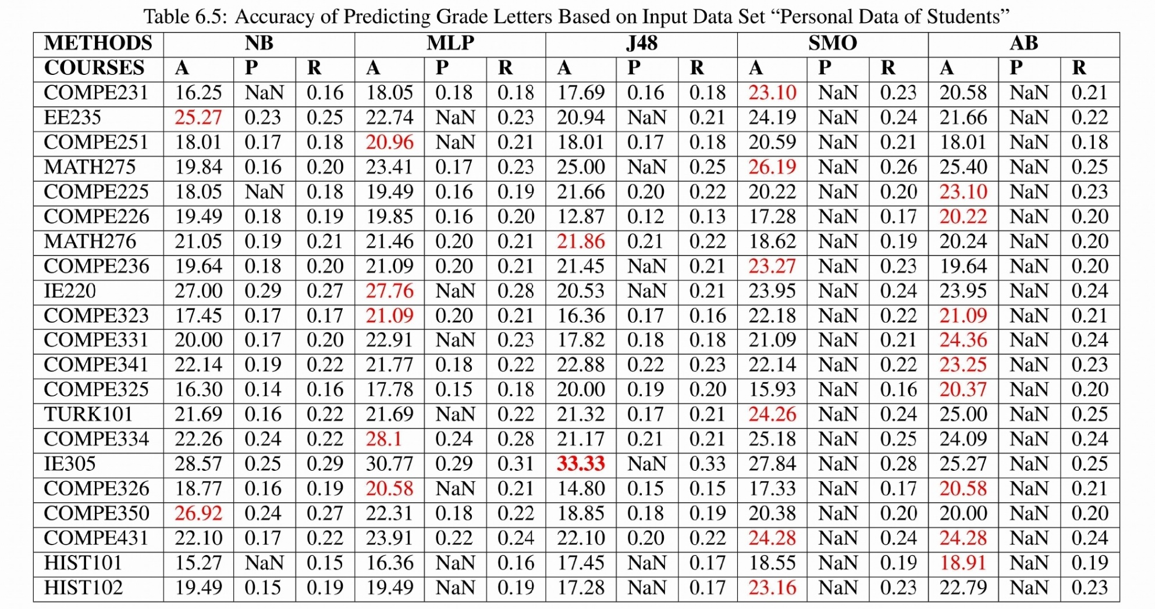
Accuracy, Weighted Precision and Weighted Recall of Predicting Target Course’s Grade Letters Based on Input Data Set “Personal Data of Students”
<number> of 42
Notes:
It can be seen from the data in Table 6.5 that the highest accuracy is 33.33 (course name: IE305, algorithm: J48, precision: NaN, recall: 0.33).
On the other hand, the lowest value is 12.87 (course name: COMPE226, algorithm: J48, precision: 0.12, recall: 0.13).
The most successful algorithm is AB, but MP and SMO come after it. Precision and recall values of results are as low as Tables of Predicting Grade Letters.
<number>

Slide 39
Accuracy, Weighted Precision and Weighted Recall of Predicting Target Course’s Grade Letters Based on Input Data Set “Personal Data of Students”
Notes:
It can be seen from the data in Table 6.5 that the highest accuracy is 33.33 (course name: IE305, algorithm: J48, precision: NaN, recall: 0.33).
On the other hand, the lowest value is 12.87 (course name: COMPE226, algorithm: J48, precision: 0.12, recall: 0.13).
The most successful algorithm is AB, but MP and SMO come after it. Precision and recall values of results are as low as Tables of Predicting Grade Letters.
<number>

Slide 40
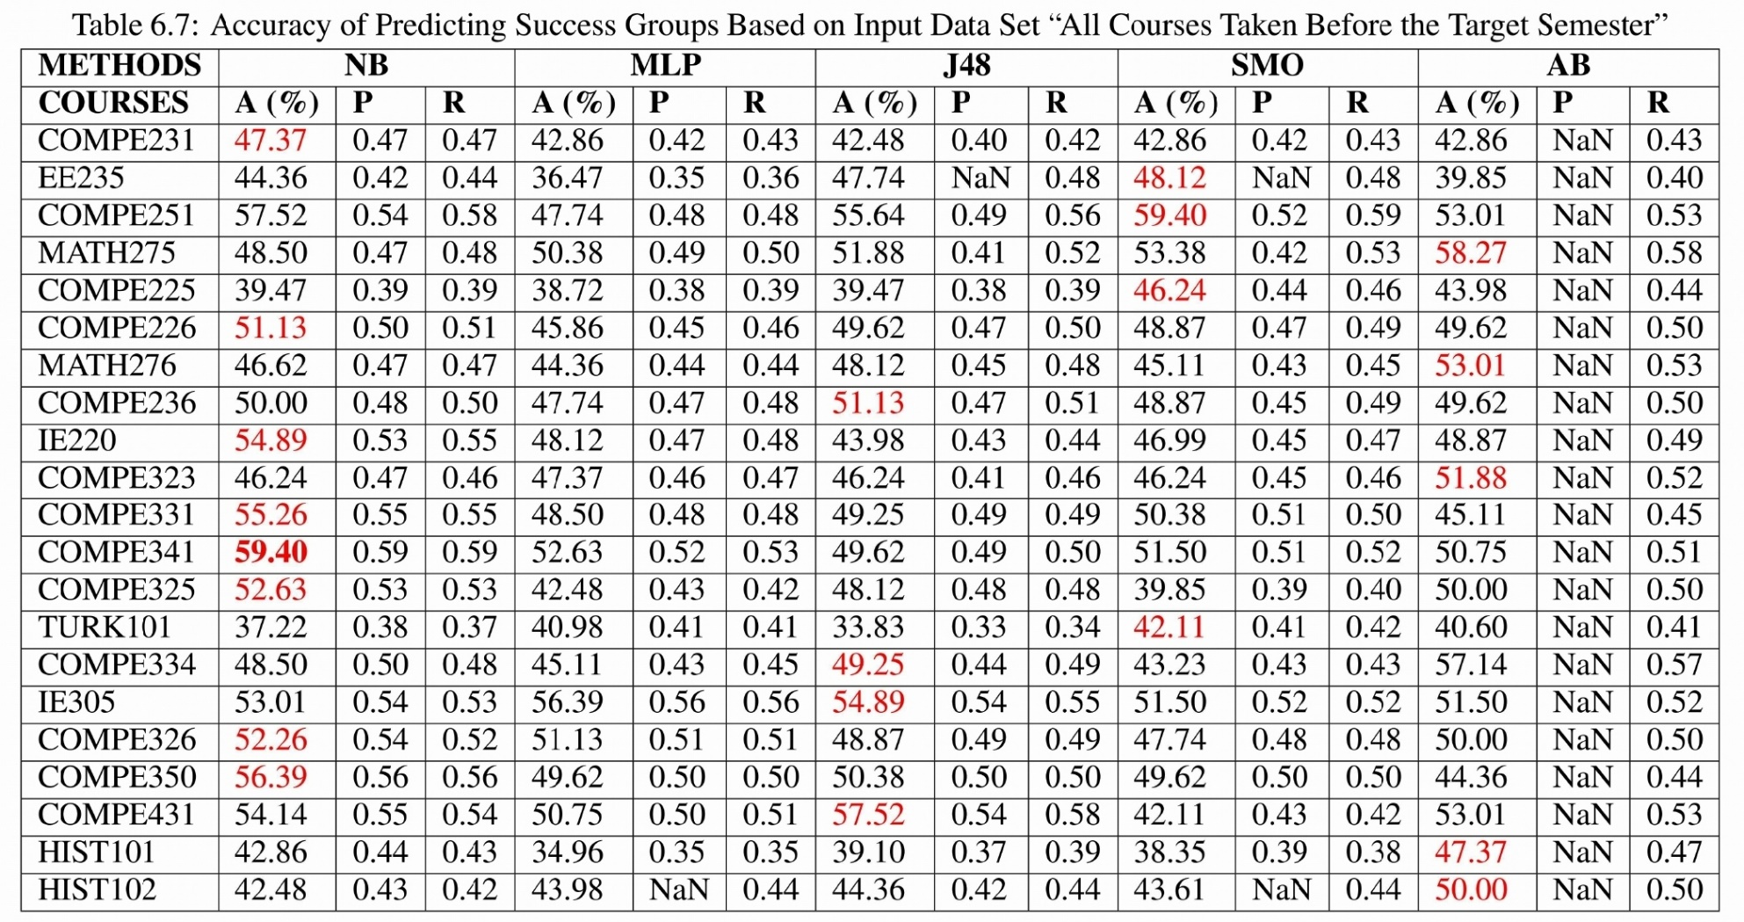
Accuracy, Weighted Precision and Weighted Recall of Predicting Target Course’s Success Groups Based on Input Data Set “All Courses Taken Before the Target Semester”
Notes:
Table 6.7 includes accuracy, recall and precision of the results.
The results show that the maximum accuracy is 59.40 (course name: COMPE251, algorithm: SMO, precision: 0.52, recall: 0.59; course name: COMPE341, algorithm: Naive Bayes, precision: 0.59, recall: 0.59), but the minimum is 33.83 (course name: TURK101, algorithm: J48, precision: 0.33, recall: 0.34).
The most successful algorithm is Naïve Bayes which has the highest percentage result corresponding to 36.84 (IE305, Naïve Bayes).
MP provides a lower performance when compared to the other algorithms.
It is observed that the three best prediction success of courses are IE305, IE220, COMPE341.
<number>

Slide 41
Accuracy, Weighted Precision and Weighted Recall of Predicting Target Course’s Success Groups Based on Input Data Set “All Courses Taken Before the Target Semester”
Notes:
Table 6.7 includes accuracy, recall and precision of the results.
The results show that the maximum accuracy is 59.40 (course name: COMPE251, algorithm: SMO, precision: 0.52, recall: 0.59; course name: COMPE341, algorithm: Naive Bayes, precision: 0.59, recall: 0.59), but the minimum is 33.83 (course name: TURK101, algorithm: J48, precision: 0.33, recall: 0.34).
The most successful algorithm is Naïve Bayes which has the highest percentage result corresponding to 36.84 (IE305, Naïve Bayes).
MP provides a lower performance when compared to the other algorithms.
It is observed that the three best prediction success of courses are IE305, IE220, COMPE341.
<number>

Slide 42
Accuracy, Weighted Precision and Weighted Recall of Predicting Target Course’s Success Groups Based on Input Data Set “All Courses Taken Before the Target Semester”
The lowest A (%) provided by MLP
Notes:
Table 6.7 includes accuracy, recall and precision of the results.
The results show that the maximum accuracy is 59.40 (course name: COMPE251, algorithm: SMO, precision: 0.52, recall: 0.59; course name: COMPE341, algorithm: Naive Bayes, precision: 0.59, recall: 0.59), but the minimum is 33.83 (course name: TURK101, algorithm: J48, precision: 0.33, recall: 0.34).
The most successful algorithm is Naïve Bayes which has the highest percentage result corresponding to 36.84 (IE305, Naïve Bayes).
MP provides a lower performance when compared to the other algorithms.
It is observed that the three best prediction success of courses are IE305, IE220, COMPE341.
<number>

Slide 43
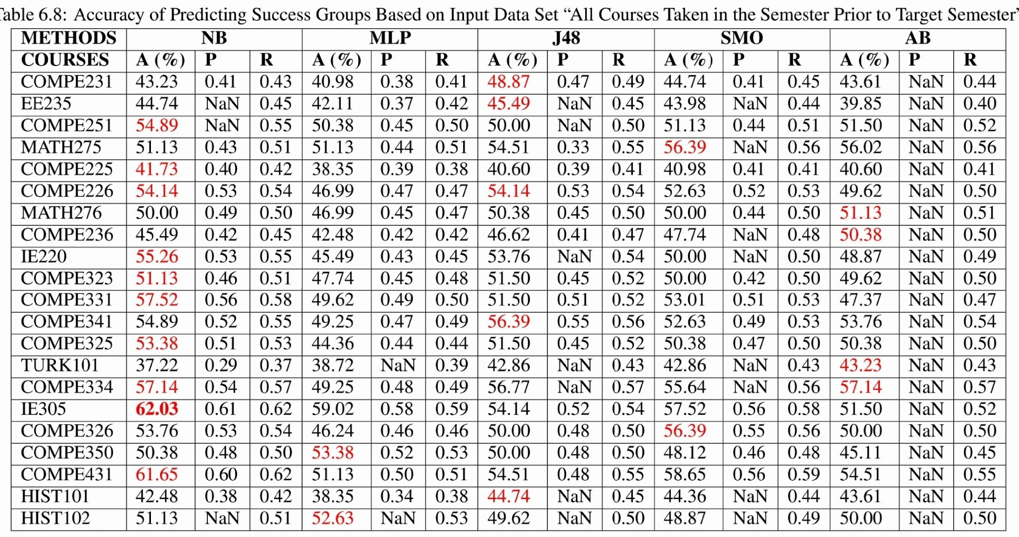
Accuracy, Weighted Precision and Weighted Recall of Predicting Target Course’s Success Groups Based on Input Data Set “All Courses Taken in the Semester Prior to Target Semester”
Notes:
Results in Table 6.8 indicate that the accuracy percentages vary between 37.22 (course name: TURK101, algorithm: Naive Bayes, precision: 0.29, recall: 0.37) and 62.03 (course name: IE305, algorithm: Naive Bayes, precision: 0.61, recall: 0.62).
From the data in the table, it is apparent that Naive Bayes gives better prediction success in most of the courses.
On the other hand, J48 gives relatively more significant prediction success results.
<number>

Slide 44
Accuracy, Weighted Precision and Weighted Recall of Predicting Target Course’s Success Groups Based on Input Data Set “All Courses Taken in the Semester Prior to Target Semester”
Notes:
Results in Table 6.8 indicate that the accuracy percentages vary between 37.22 (course name: TURK101, algorithm: Naive Bayes, precision: 0.29, recall: 0.37) and 62.03 (course name: IE305, algorithm: Naive Bayes, precision: 0.61, recall: 0.62).
From the data in the table, it is apparent that Naive Bayes gives better prediction success in most of the courses.
On the other hand, J48 gives relatively more significant prediction success results.
<number>

Slide 45
Accuracy, Weighted Precision and Weighted Recall of Predicting Target Course’s Success Groups Based on Input Data Set “All Courses Taken in the Semester Prior to Target Semester”
Notes:
Results in Table 6.8 indicate that the accuracy percentages vary between 37.22 (course name: TURK101, algorithm: Naive Bayes, precision: 0.29, recall: 0.37) and 62.03 (course name: IE305, algorithm: Naive Bayes, precision: 0.61, recall: 0.62).
From the data in the table, it is apparent that Naive Bayes gives better prediction success in most of the courses.
On the other hand, J48 gives relatively more significant prediction success results.
<number>

Slide 46
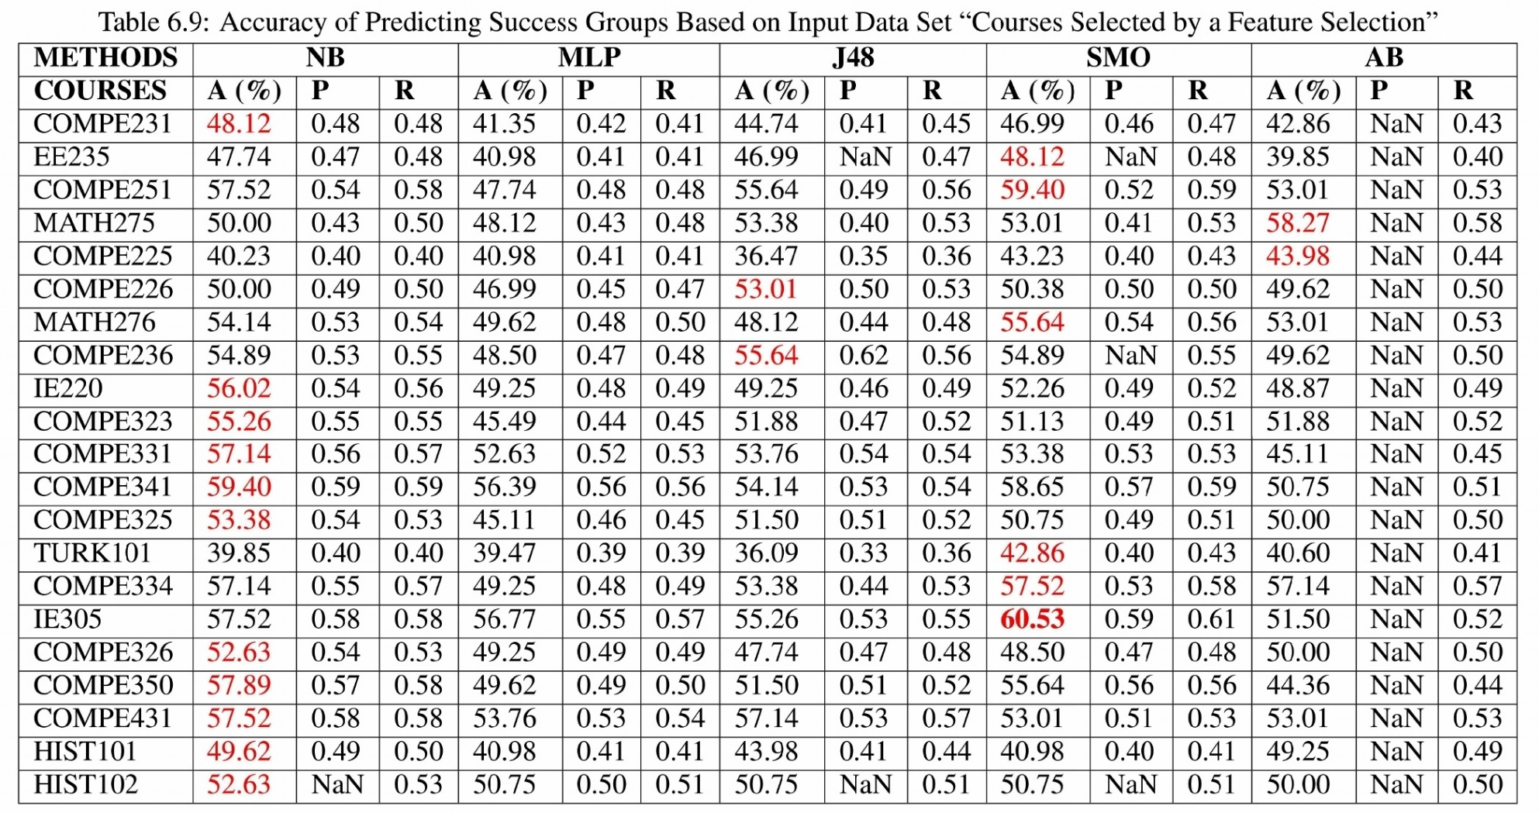
Accuracy, Weighted Precision and Weighted Recall of Predicting Target Course’s Success Groups Based on Input Data Set “Courses Selected by a Feature Selection”
Notes:
From Table 6.9 above, it can be seen that the accuracy percentages range between 36.09 (course name: TURK101, algorithm: J48, precision: 0.33, recall: 0.36) and 60.53 (course name: IE305, algorithm: Naive Bayes, precision: 0.58, recall: 0.58).
Naive Bayes gives the best prediction success, but SMO comes the second.
Multilayer Perceptron does not provide any maximum percentage accuracy, recall and precision in courses.
<number>

Slide 47
Accuracy, Weighted Precision and Weighted Recall of Predicting Target Course’s Success Groups Based on Input Data Set “Courses Selected by a Feature Selection”
Notes:
From Table 6.9 above, it can be seen that the accuracy percentages range between 36.09 (course name: TURK101, algorithm: J48, precision: 0.33, recall: 0.36) and 60.53 (course name: IE305, algorithm: Naive Bayes, precision: 0.58, recall: 0.58).
Naive Bayes gives the best prediction success, but SMO comes the second.
Multilayer Perceptron does not provide any maximum percentage accuracy, recall and precision in courses.
<number>

Slide 48
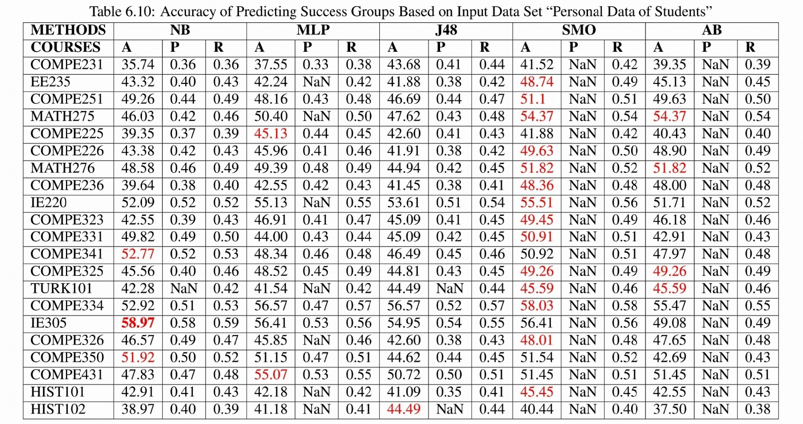
Accuracy, Weighted Precision and Weighted Recall of Predicting Target Course’s Success Groups Based on Input Data Set “Personal Data of Students”
Notes:
Table 6.10 provides the accuracy, recall and precision results in order to predict the Target Course of applied Personal Data of Students Data Input Set.
The maximum accuracy is 58.97 (course name: IE305, algorithm: Naive Bayes, precision: 0.58, recall: 0,59).
However, SMO is the most successful algorithm in predicting Target Courses.
<number>

Slide 49
Accuracy, Weighted Precision and Weighted Recall of Predicting Target Course’s Success Groups Based on Input Data Set “Personal Data of Students”
Notes:
Table 6.10 provides the accuracy, recall and precision results in order to predict the Target Course of applied Personal Data of Students Data Input Set.
The maximum accuracy is 58.97 (course name: IE305, algorithm: Naive Bayes, precision: 0.58, recall: 0,59).
However, SMO is the most successful algorithm in predicting Target Courses.
<number>

Slide 50
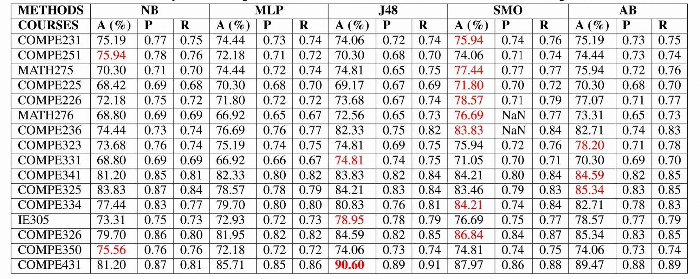
Accuracy, Weighted Precision and Weighted Recall of Predicting Target Course’s Fail-Pass State Based on Input Data Set “All Courses Taken Before the Target Semester”
Notes:
The results show that the passing accuracy percentages range between 66.92 (course name: COMPE331, algorithm: Multilayer Perceptron, precision: 0.65, recall: 0.67; course name: MATH276, algorithm: MultilayerPerceptron, precision: 0,58, recall: 0,59). And 90.60 (course name: COMPE431, algorithm: J48, precision: 0.89, recall: 0.91) as shown in Table 6.12.
Additionally, SMO is taken into consideration that gives better prediction success with respect other algorithms. Interestingly, it is observed that if the course is closer to the last semesters, higher prediction success can be seen more frequently
<number>

Slide 51
Accuracy, Weighted Precision and Weighted Recall of Predicting Target Course’s Fail-Pass State Based on Input Data Set “All Courses Taken Before the Target Semester”
Notes:
The results show that the passing accuracy percentages range between 66.92 (course name: COMPE331, algorithm: Multilayer Perceptron, precision: 0.65, recall: 0.67; course name: MATH276, algorithm: MultilayerPerceptron, precision: 0,58, recall: 0,59). And 90.60 (course name: COMPE431, algorithm: J48, precision: 0.89, recall: 0.91) as shown in Table 6.12.
Additionally, SMO is taken into consideration that gives better prediction success with respect other algorithms. Interestingly, it is observed that if the course is closer to the last semesters, higher prediction success can be seen more frequently
<number>

Slide 52
Accuracy, Weighted Precision and Weighted Recall of Predicting Target Course’s Fail-Pass State Based on Input Data Set “All Courses Taken Before the Target Semester”
Notes:
The results show that the passing accuracy percentages range between 66.92 (course name: COMPE331, algorithm: Multilayer Perceptron, precision: 0.65, recall: 0.67; course name: MATH276, algorithm: MultilayerPerceptron, precision: 0,58, recall: 0,59). And 90.60 (course name: COMPE431, algorithm: J48, precision: 0.89, recall: 0.91) as shown in Table 6.12.
Additionally, SMO is taken into consideration that gives better prediction success with respect other algorithms. Interestingly, it is observed that if the course is closer to the last semesters, higher prediction success can be seen more frequently
<number>

Slide 53
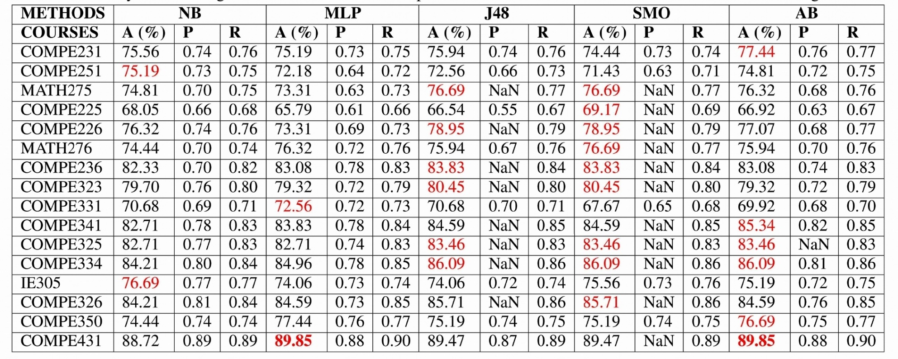
Accuracy, Weighted Precision and Weighted Recall of Predicting Target Course’s Fail-Pass State Based on Input Data Set “All Courses Taken in the Semester Prior to Target Semester”
Notes:
From the below presented graphic, it can be seen that that the prediction of passing accuracy is between 65.79 (course name: COMPE225, algorithm: Multilayer Perceptron, precision: 0.61, recall: 0.66) and 89.85 (course name: COMPE431, algorithm: Multilayer Perceptron, precision: 0.88, recall: 0.90; course name: COMPE431, algorithm: AdaBoostM1, precision: 0.88, recall: 0.90). SMO and J48 give better accuracy, recall, and precision when compared to AB, MP and NB for each course.
<number>

Slide 54
Accuracy, Weighted Precision and Weighted Recall of Predicting Target Course’s Fail-Pass State Based on Input Data Set “All Courses Taken in the Semester Prior to Target Semester”
Notes:
From the below presented graphic, it can be seen that that the prediction of passing accuracy is between 65.79 (course name: COMPE225, algorithm: Multilayer Perceptron, precision: 0.61, recall: 0.66) and 89.85 (course name: COMPE431, algorithm: Multilayer Perceptron, precision: 0.88, recall: 0.90; course name: COMPE431, algorithm: AdaBoostM1, precision: 0.88, recall: 0.90). SMO and J48 give better accuracy, recall, and precision when compared to AB, MP and NB for each course.
<number>

Slide 55
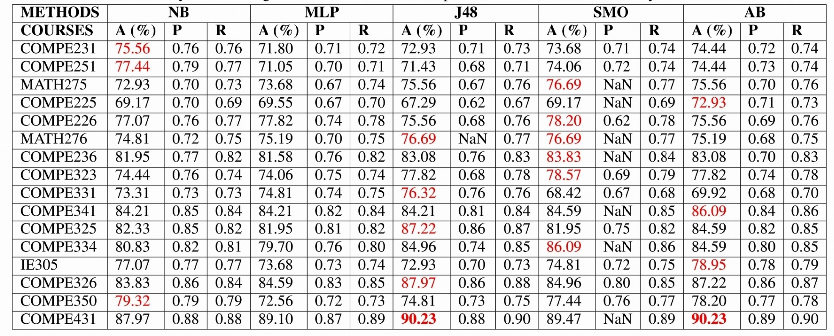
Accuracy, Weighted Precision and Weighted Recall of Predicting Target Course’s Fail-Pass State Based on Input Data Set “Courses Selected by a Feature Selection”
Notes:
Table 6.14 presents the percentage of correctly predicted Fail-Pass State of students, accuracy and recall values of predicted states. The maximum accuracy corresponds to 67.29 (course name: COMPE225, algorithm: J48, precision: 0.62, recall: 0.67).
However, the minimum is 90.23 (course name: COMPE431, algorithm: J48, precision: 0.88, recall: 0.90; course name: COMPE431, algorithm: AdaBoostM1, precision: 0.89, recall: 0.90). It is observed that SMO and J48 give better a prediction success than the other algorithms for most of the courses.
On the other hand, there is a significant prediction success in AB and it has the maximum prediction success in the results. Multilayer and NB do not provide enough predicting performance in this input set.
<number>

Slide 56
Accuracy, Weighted Precision and Weighted Recall of Predicting Target Course’s Fail-Pass State Based on Input Data Set “Courses Selected by a Feature Selection”
Notes:
Table 6.14 presents the percentage of correctly predicted Fail-Pass State of students, accuracy and recall values of predicted states. The maximum accuracy corresponds to 67.29 (course name: COMPE225, algorithm: J48, precision: 0.62, recall: 0.67).
However, the minimum is 90.23 (course name: COMPE431, algorithm: J48, precision: 0.88, recall: 0.90; course name: COMPE431, algorithm: AdaBoostM1, precision: 0.89, recall: 0.90). It is observed that SMO and J48 give better a prediction success than the other algorithms for most of the courses.
On the other hand, there is a significant prediction success in AB and it has the maximum prediction success in the results. Multilayer and NB do not provide enough predicting performance in this input set.
<number>

Slide 57
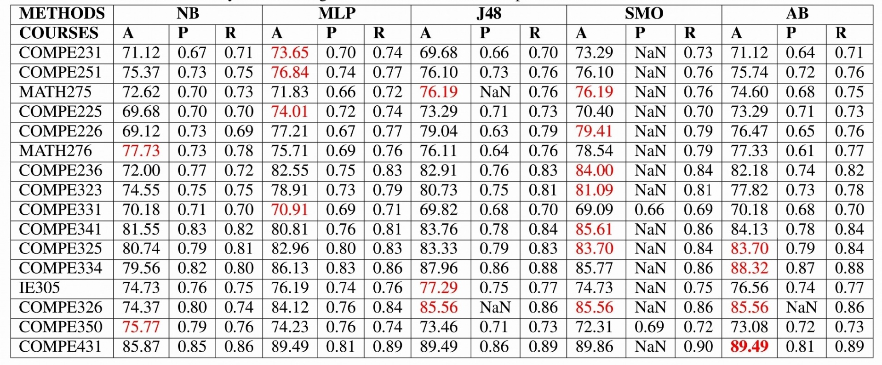
Accuracy, Weighted Precision and Weighted Recall of Predicting Target Course’s Fail-Pass State Based on Input Data Set “Personal Data of Students”
Notes:
The accuracy, recall, and precision of predicted Target Course are presented in Table 6.15.
The maximum accuracy is 89.49 (precision: 0.81, recall: 0.89) from COMPE431 in which AB algorithm is applied.
On the other hand, the lowest corresponds to COMPE231 with an accuracy of 69.68 (precision: 0.66, recall: 0.70) in J48 algorithm.
What is interesting in this table is that the last course (COMPE431) has the maximum prediction success. However, the minimum is from the first course (COMPE231) in the table.
The prediction success increases as the courses come closer to last semesters.
Furthermore, SMO is observed to have the most successful prediction success throughout the algorithms.
<number>

Slide 58
Accuracy, Weighted Precision and Weighted Recall of Predicting Target Course’s Fail-Pass State Based on Input Data Set “Personal Data of Students”
Notes:
The accuracy, recall, and precision of predicted Target Course are presented in Table 6.15.
The maximum accuracy is 89.49 (precision: 0.81, recall: 0.89) from COMPE431 in which AB algorithm is applied.
On the other hand, the lowest corresponds to COMPE231 with an accuracy of 69.68 (precision: 0.66, recall: 0.70) in J48 algorithm.
What is interesting in this table is that the last course (COMPE431) has the maximum prediction success. However, the minimum is from the first course (COMPE231) in the table.
The prediction success increases as the courses come closer to last semesters.
Furthermore, SMO is observed to have the most successful prediction success throughout the algorithms.
<number>

Slide 59
Discussion, Conclusion, Findings
The high or bad grades predicted better than the average grades.
The reason might be that most successful and unseccuesful students might perform similar success throughout their university lives.
Predicting the passing of students gives with high prediction success rather than predicting failing student success.
Passing percentage of any course is at least 65%.

Slide 60
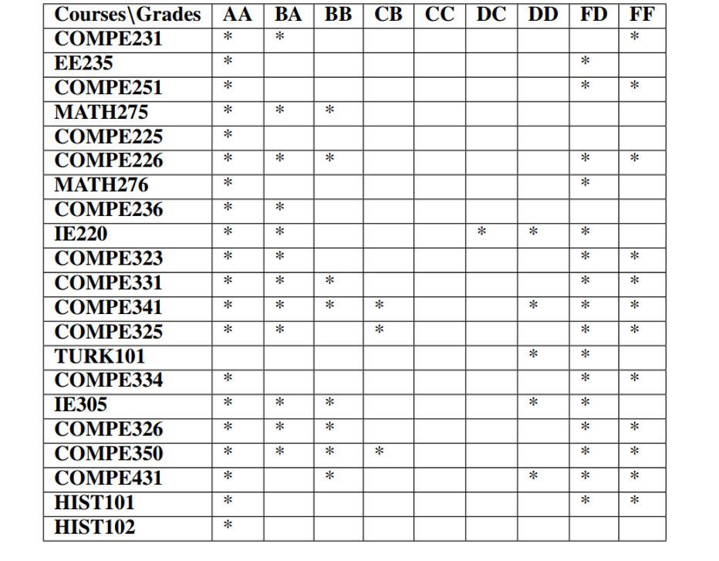
Prediction of Success Groups
Any of prediction success of algorithms gives 0.7 or upper ROC Area

Slide 61
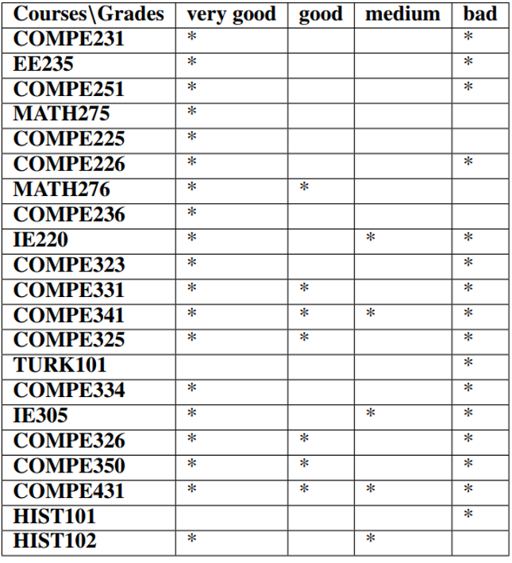
Prediction of Success Groups
Any of prediction success of algorithms gives 0.7 or upper ROC Area

Slide 62
Discussion, Conclusion, Findings
There is no strong difference between input data sets except personal data of students (PDS).
Eg. Results of COMPE326 in Fail-Pass State with Naïve Bayes algorithms:
“All Courses Taken Before the Target Semester”: Accuracy: 79.70.
“All Courses Taken in the Semester Prior to Target Semester”: Accuracy: 84.21
“Courses Selected by a Feature Selection”: Accuracy: 83.83
“Personal Data of Students”: Algorithm: Accuracy: 74.37

Slide 63
Discussion, Conclusion, Findings
More last courses in semesters have better prediction success than initial semesters’ courses.
This might be because of that students are good at taking exams in last semesters.
Naive Bayes gives better prediction success in most of results. Only in Fail-Pass State SMO has better predicition success.
It as good at independent attributes.
The IE305 has the best prediction success in most of results.
The balanced distribution is observed on IE305’s data.

Slide 64
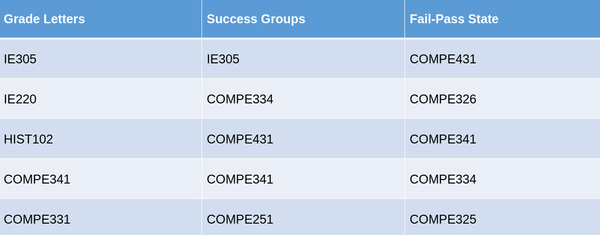
Courses based on best predication success

Slide 65
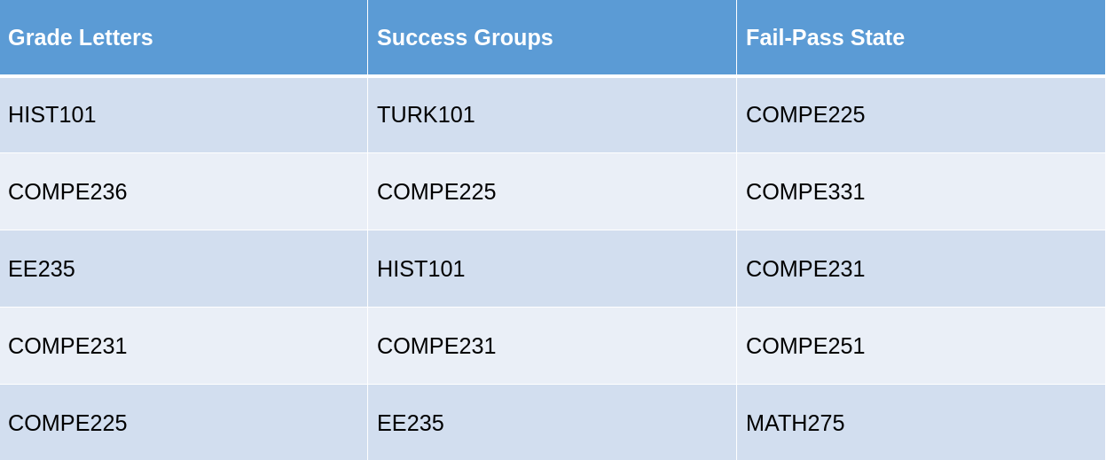
Courses which has the lowest prediction success

Slide 66
Future Work
Warning of student failure software application
Scores of University Entrance Exam
Assignments

Slide 67
Papers
Published in | Title | Authors | Year
International Journal of Engineering Education (IJEE) | Analyzing Students’ Academic Success in Pre-requisite Course Chains: A Case Study in Turkey | Murat Karakaya, Meltem Eryilmaz and Ulas Ceyhan | 2018
Oral presentation at the International Conference on Engineering and Natural Sciences (ICENS) | Investigating Students Success On Prerequisite Chain Courses | Murat Karakaya, Ulas Ceyhan | 2016

Slide 68
Questions, Answers

Slide 69
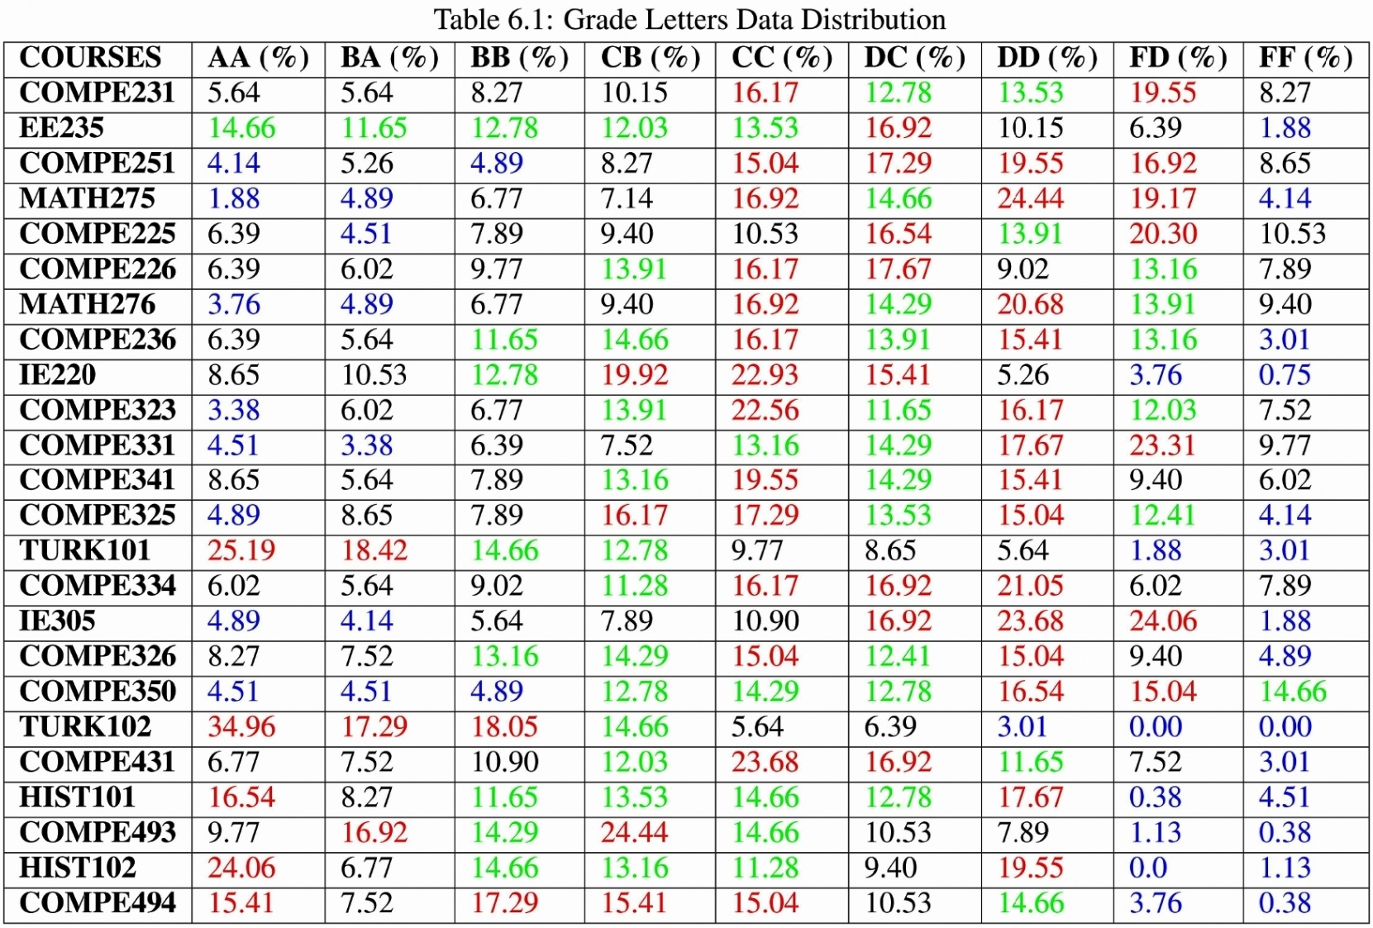
<number>

Slide 70
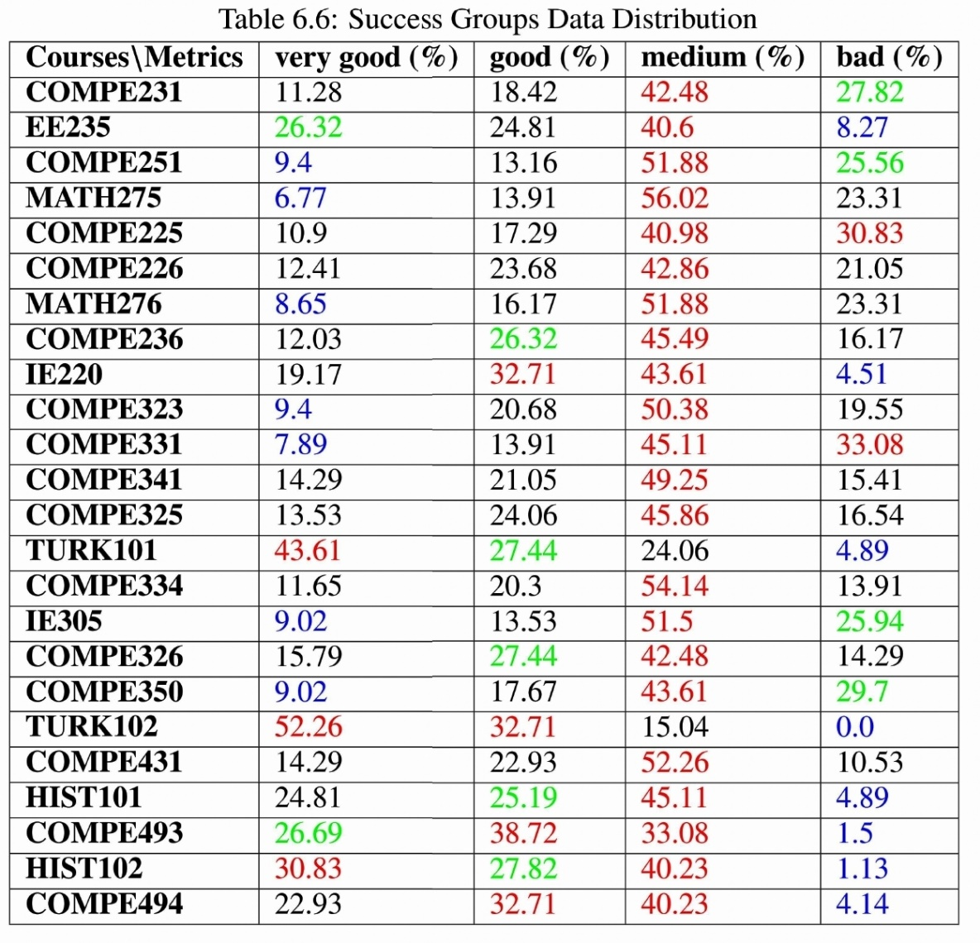
<number>

Slide 71
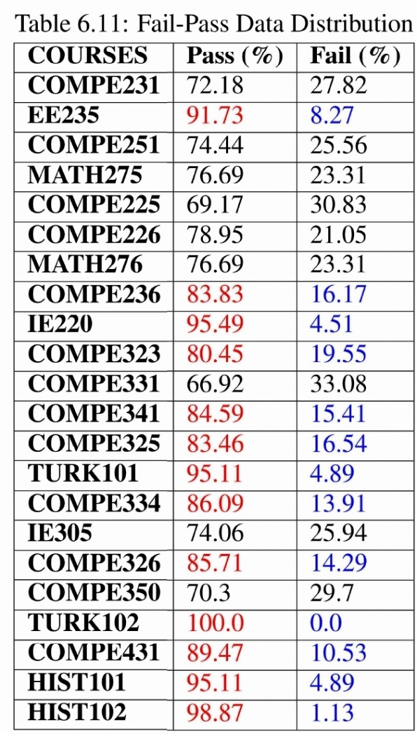
<number>

Slide 72
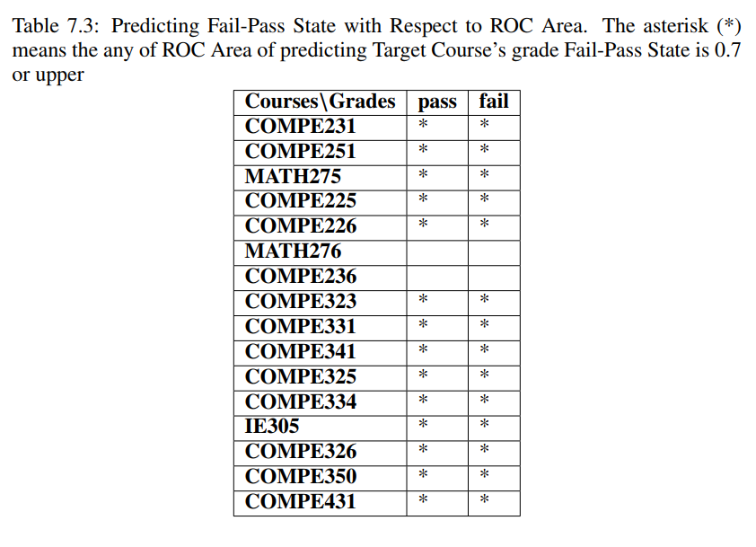
<number>

Slide 73
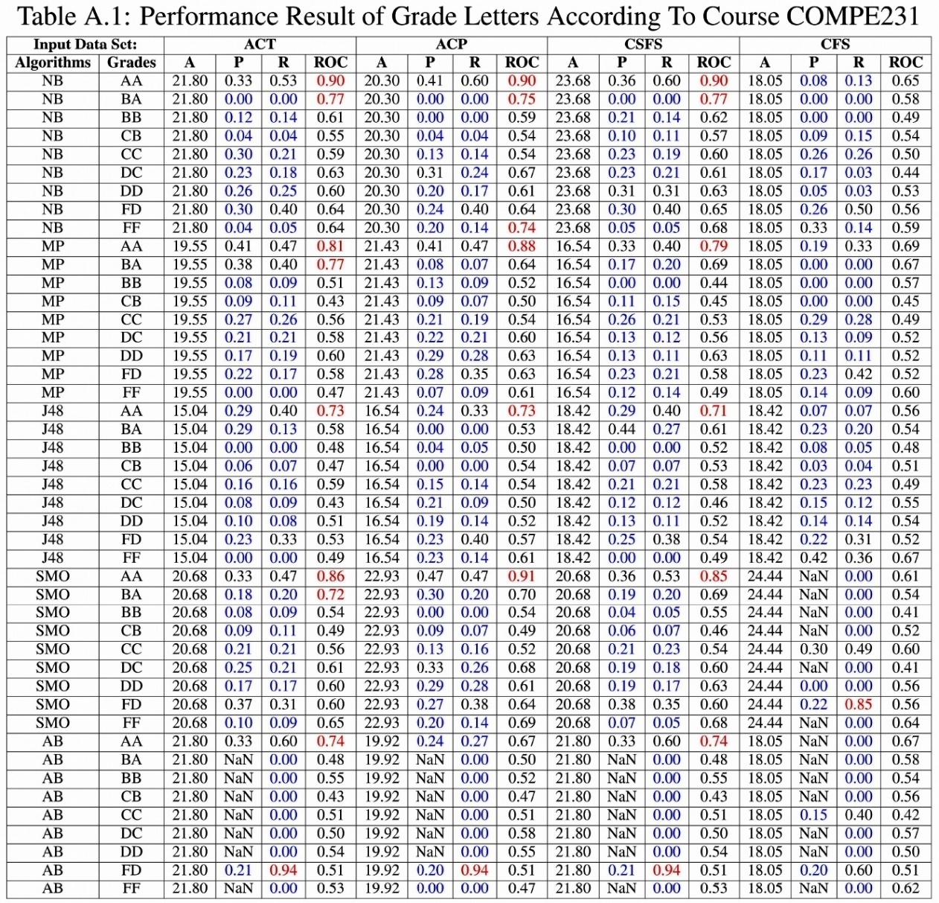
<number>

Slide 74
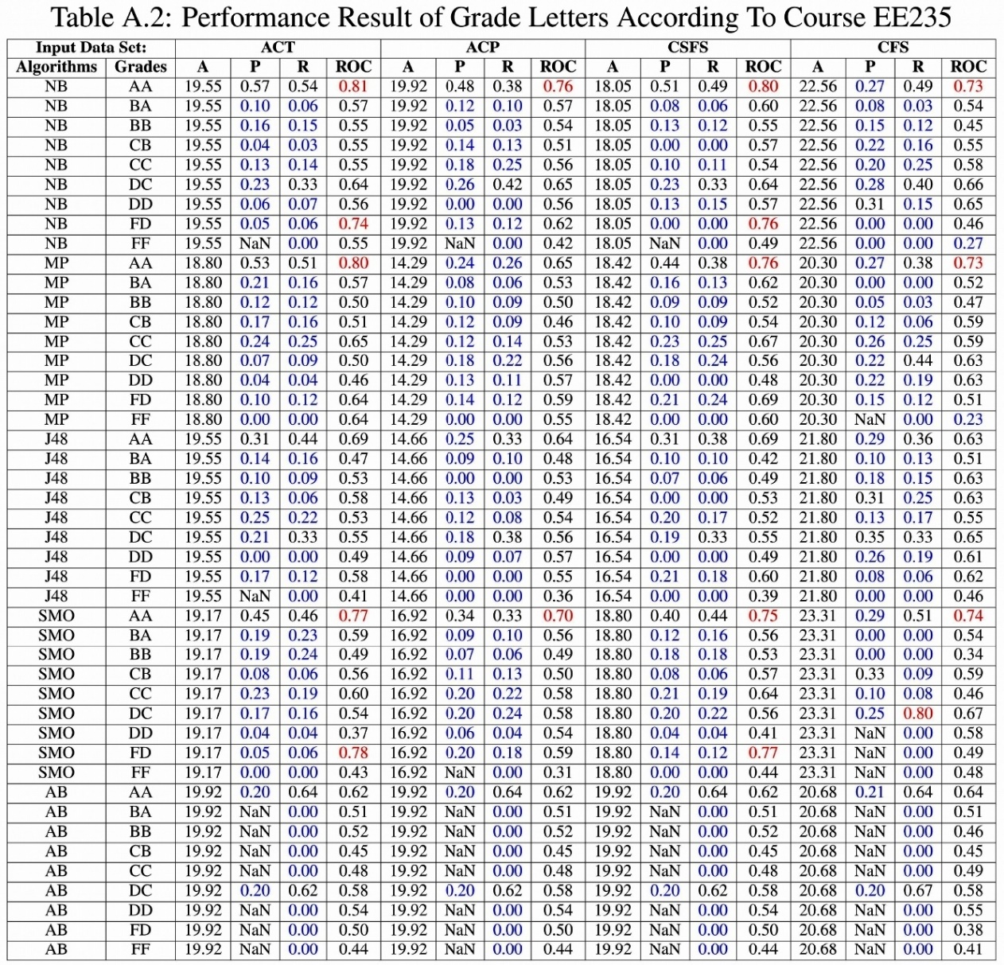
<number>

Slide 75
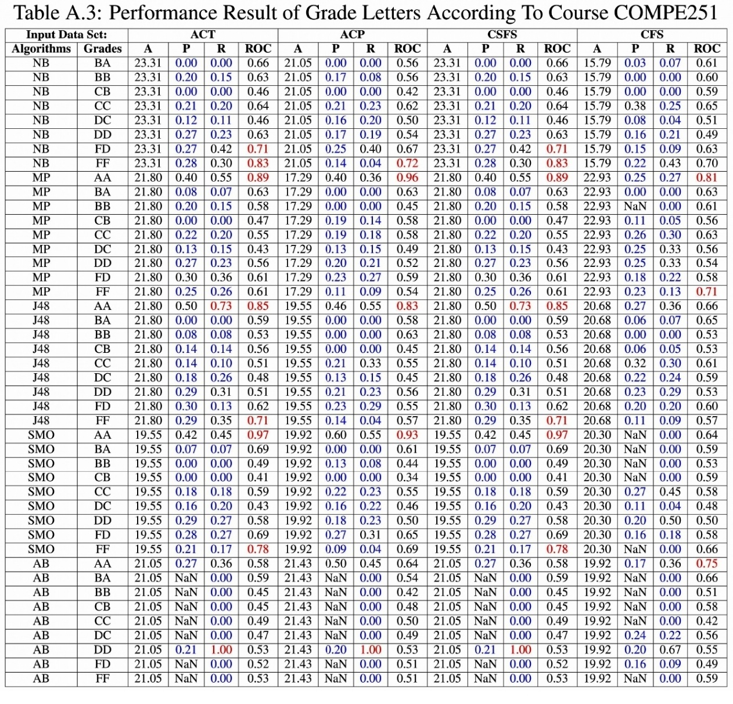
<number>

Slide 76
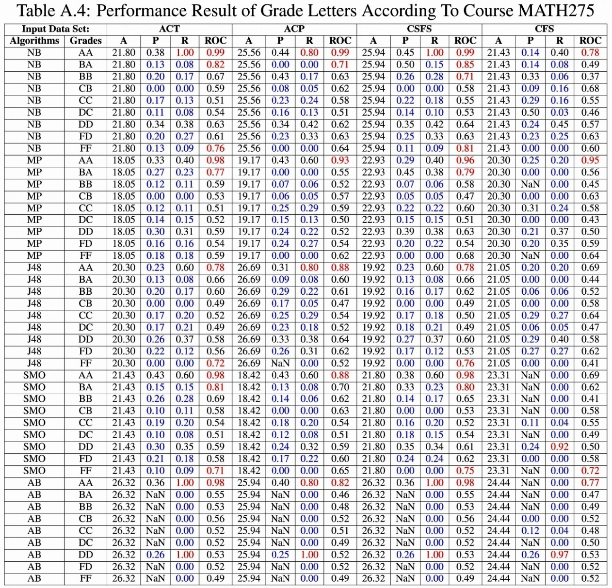
<number>

Slide 77
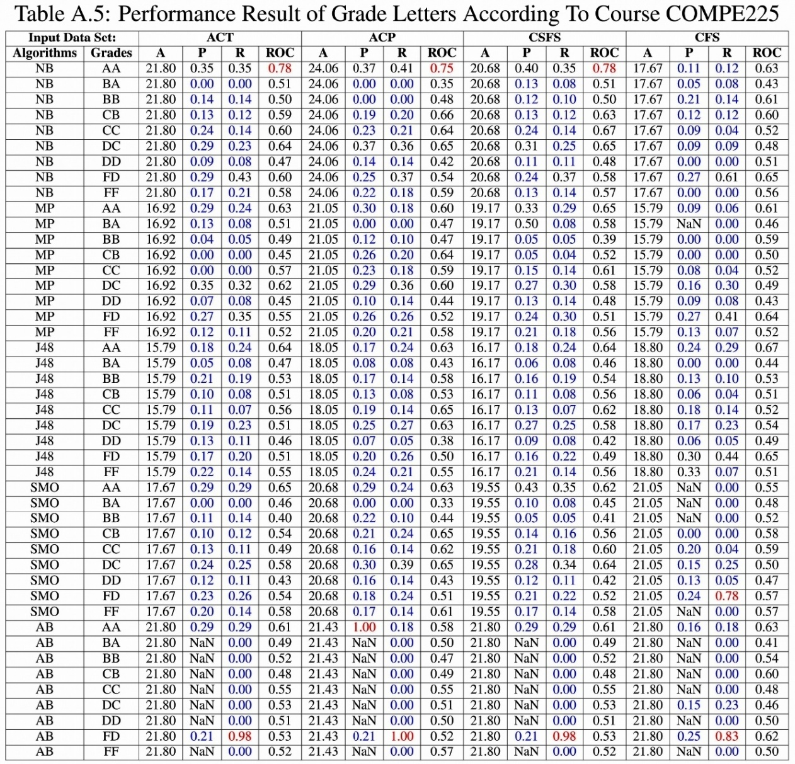
<number>

Slide 78
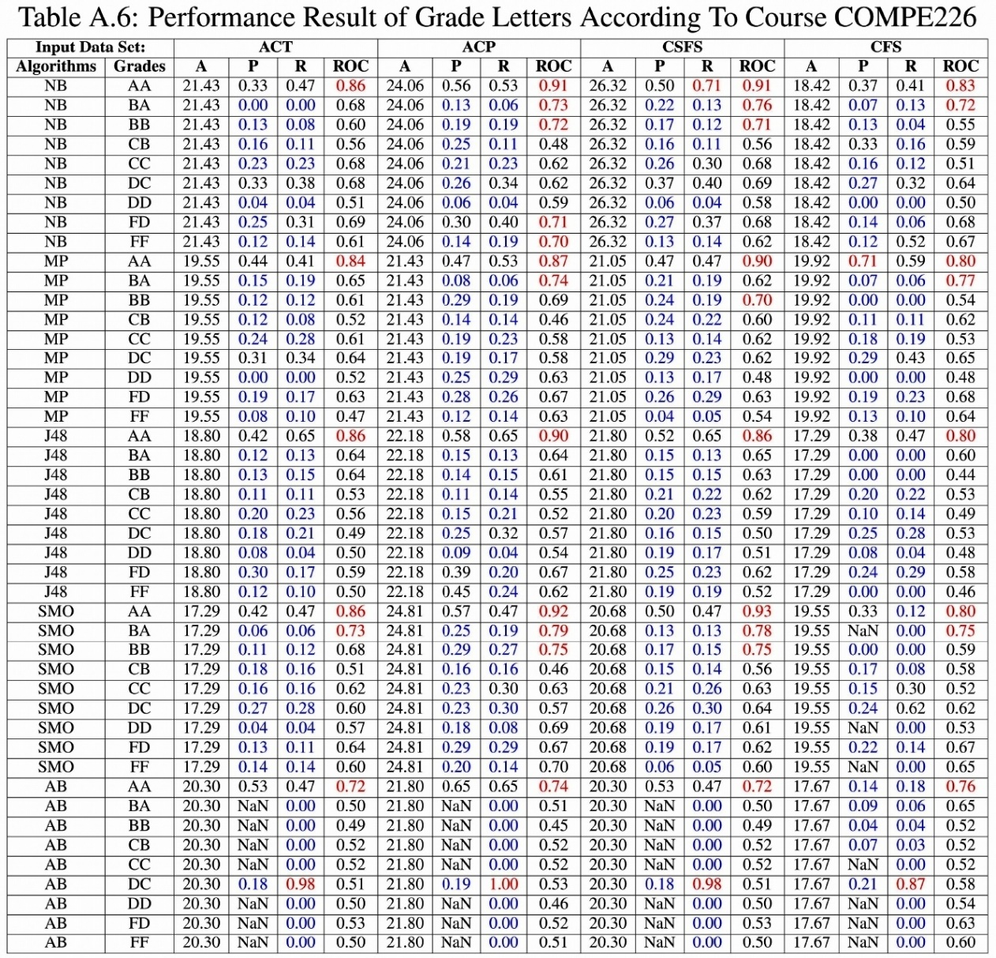
<number>

Slide 79
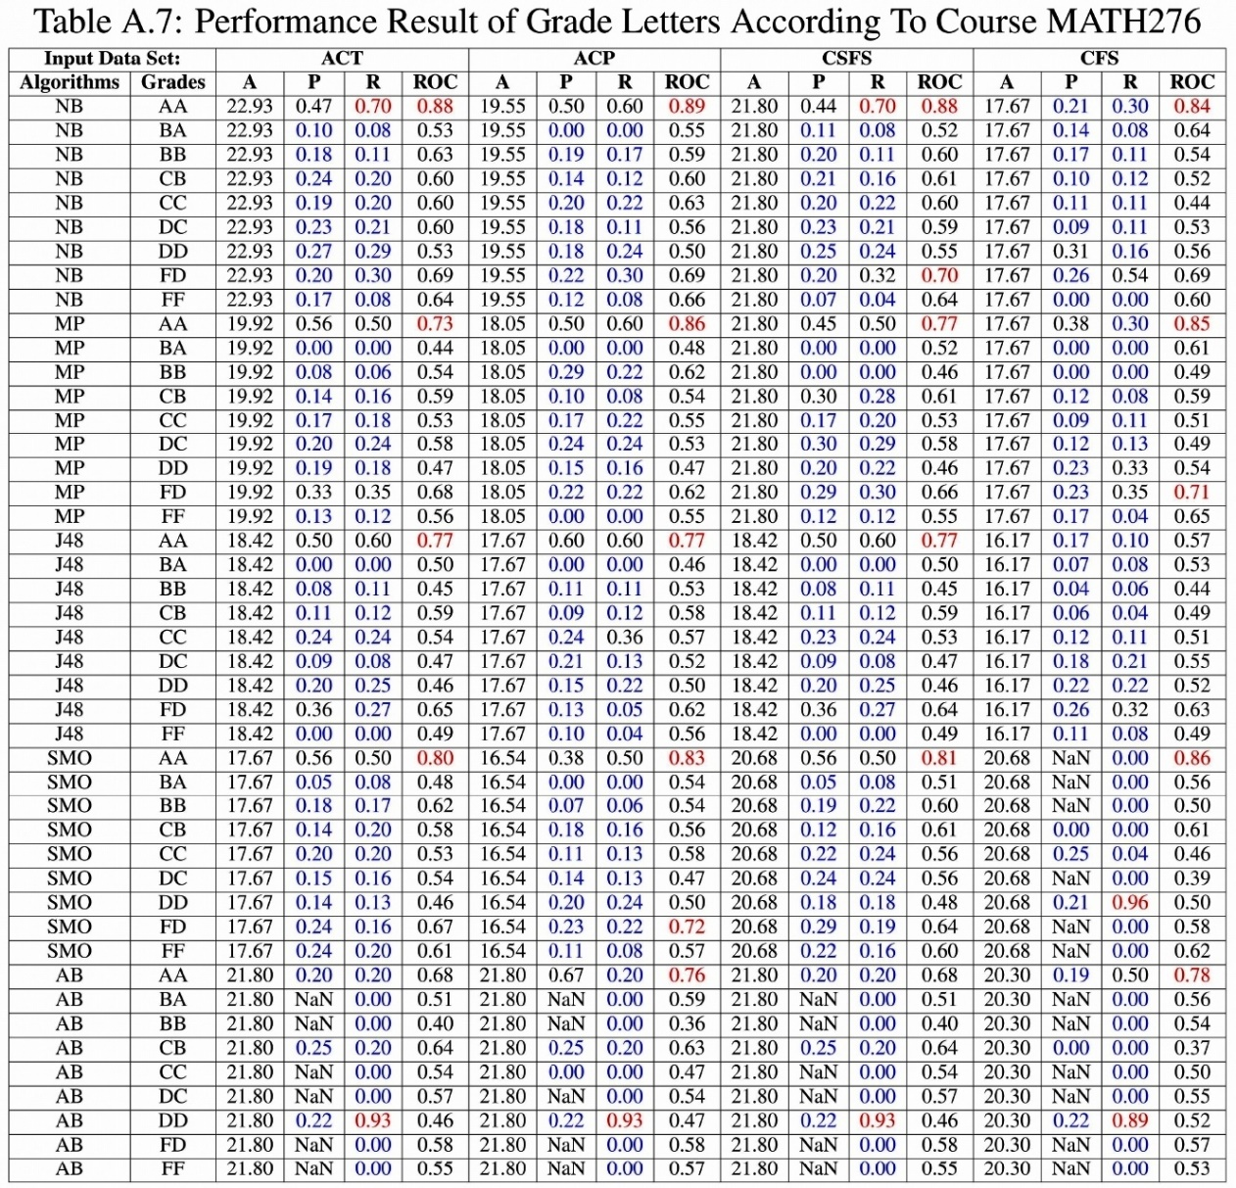
<number>

Slide 80
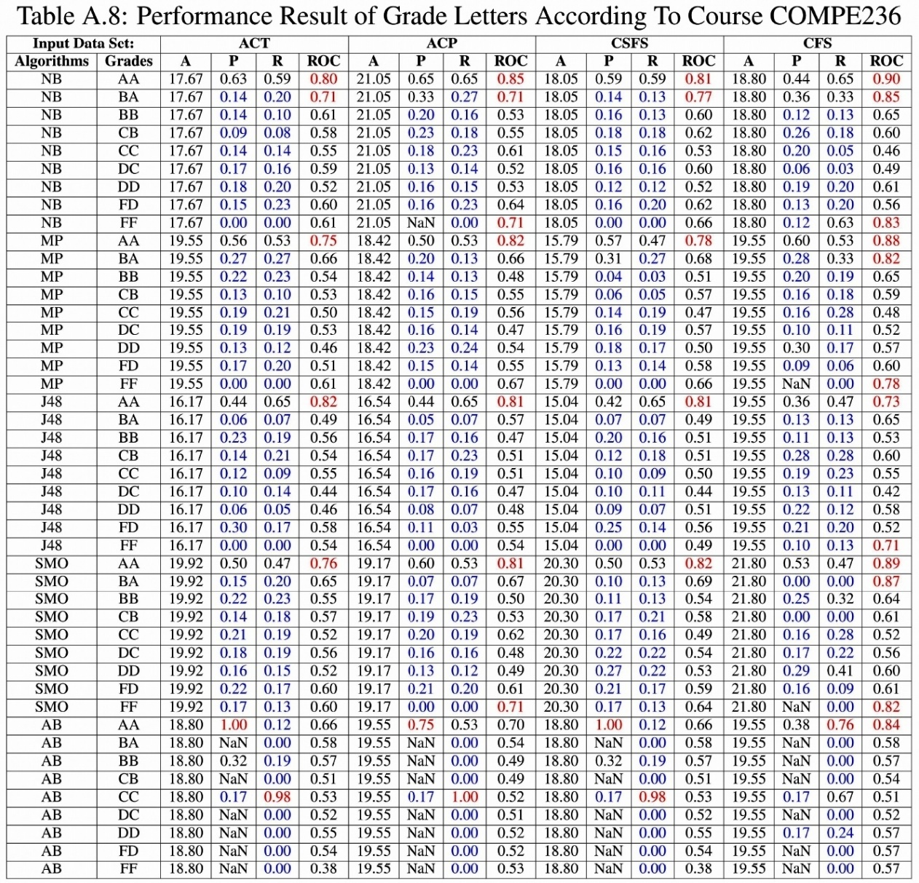
<number>

Slide 81
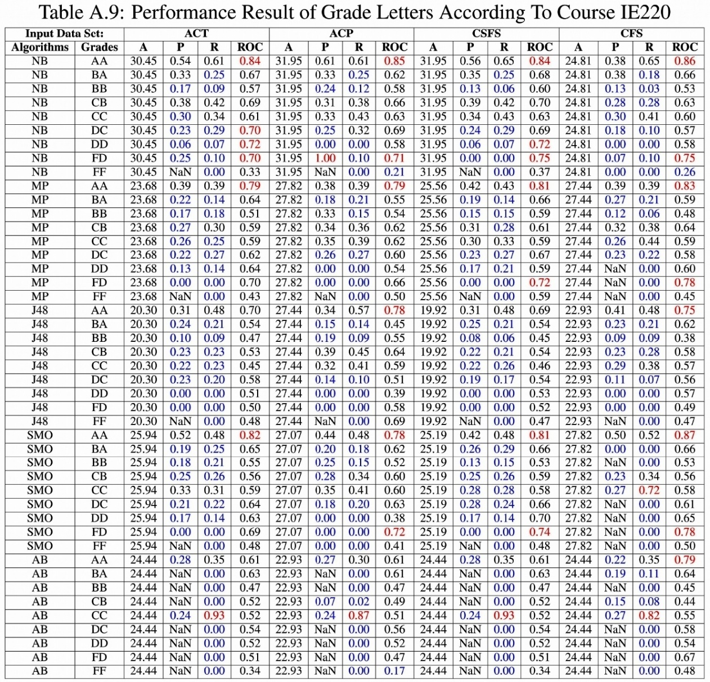
<number>

Slide 82
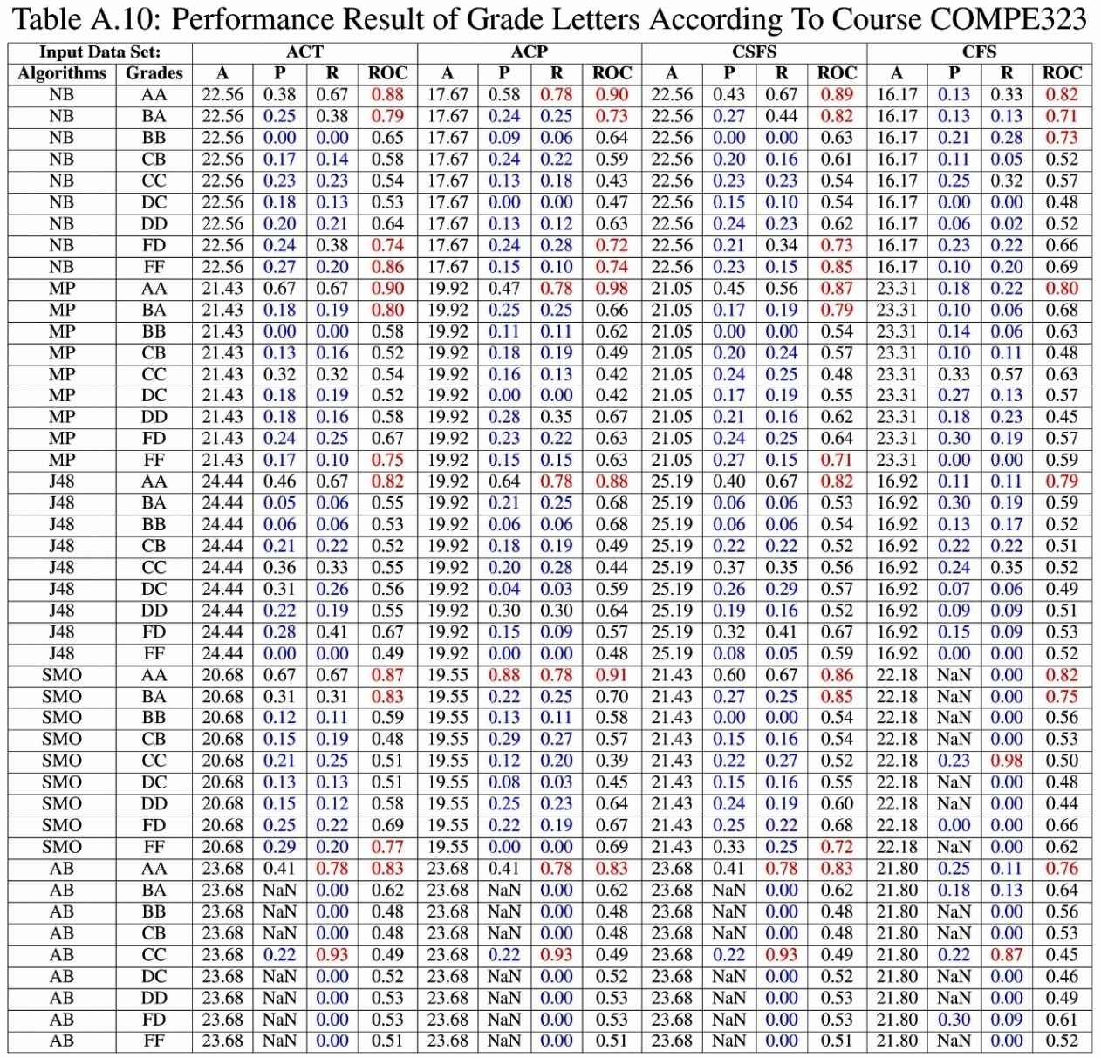
<number>

Slide 83
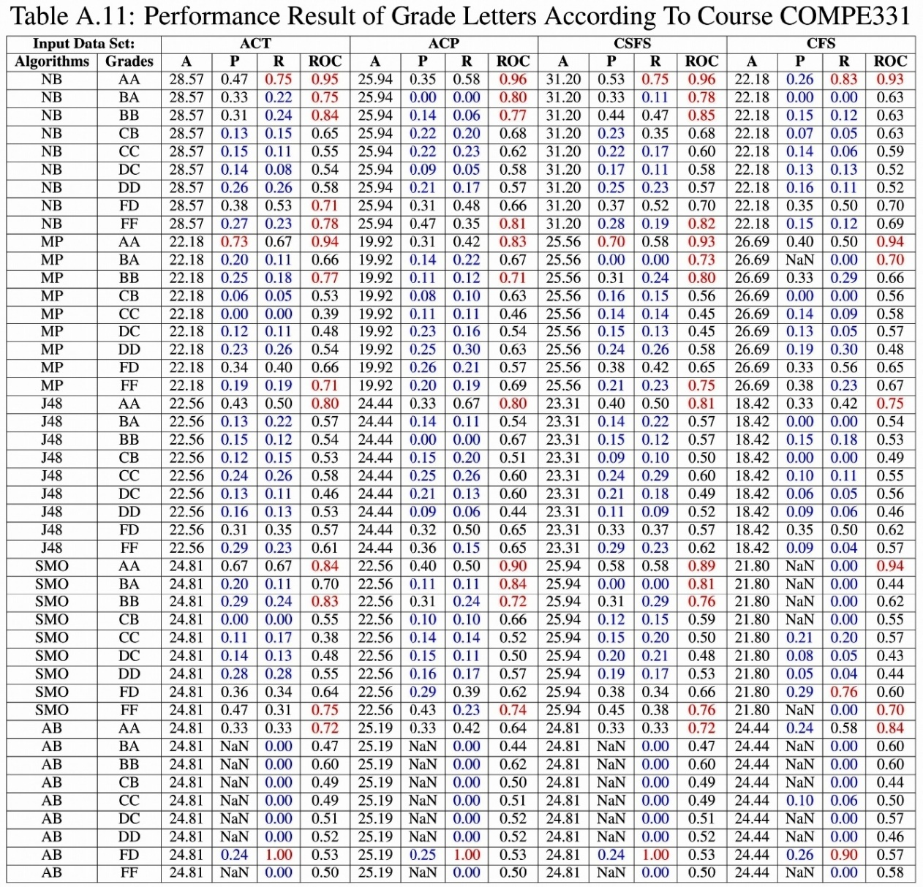
<number>

Slide 84
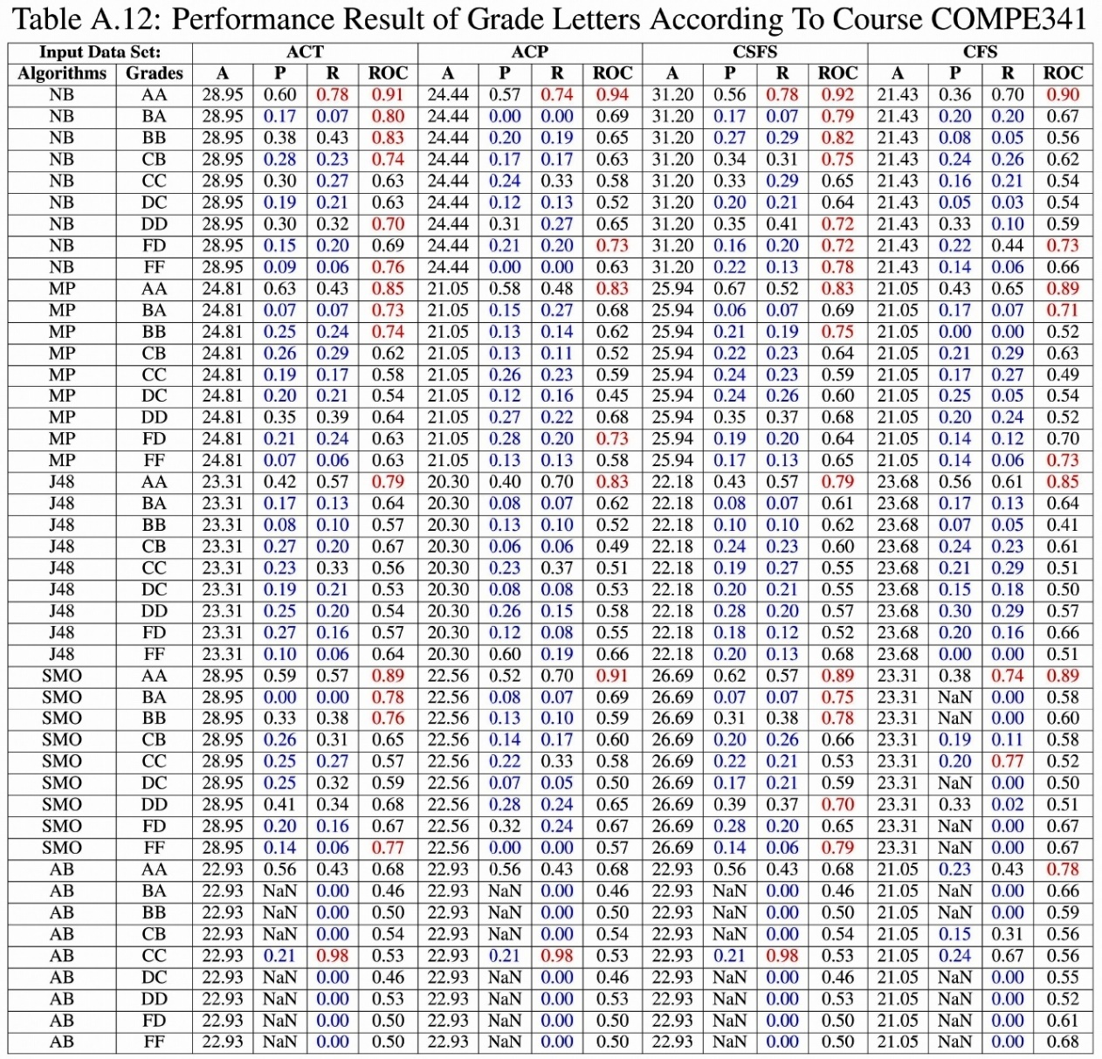
<number>

Slide 85
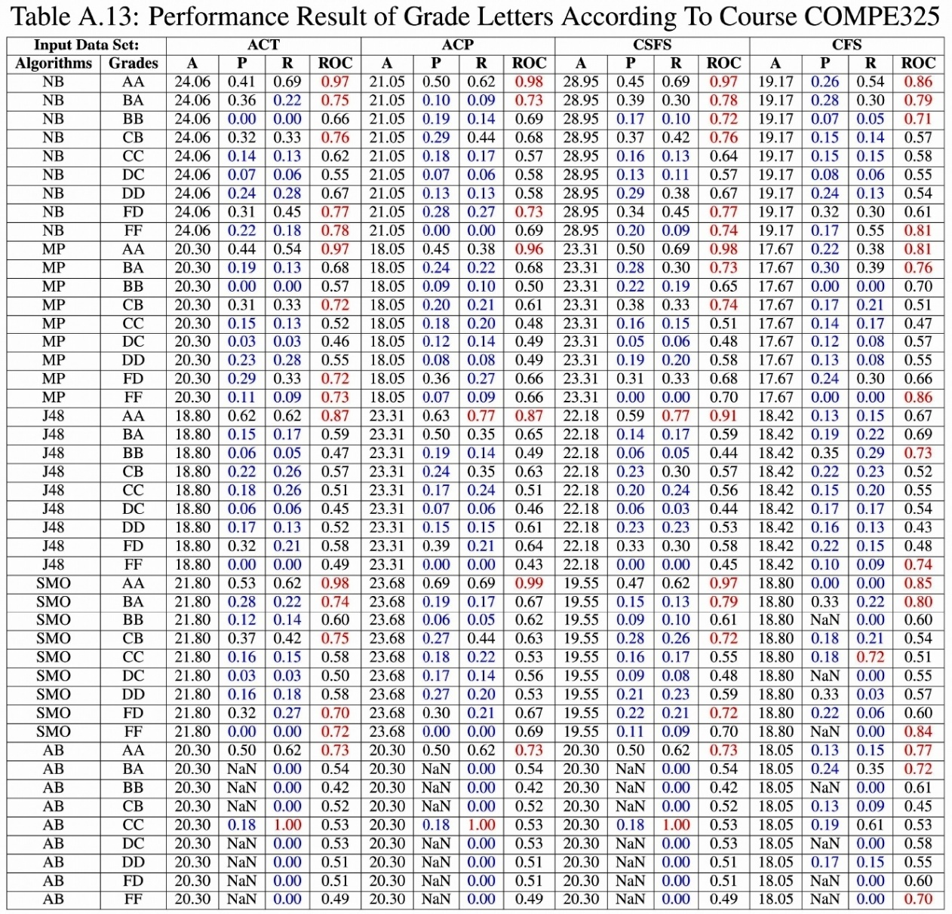
<number>

Slide 86
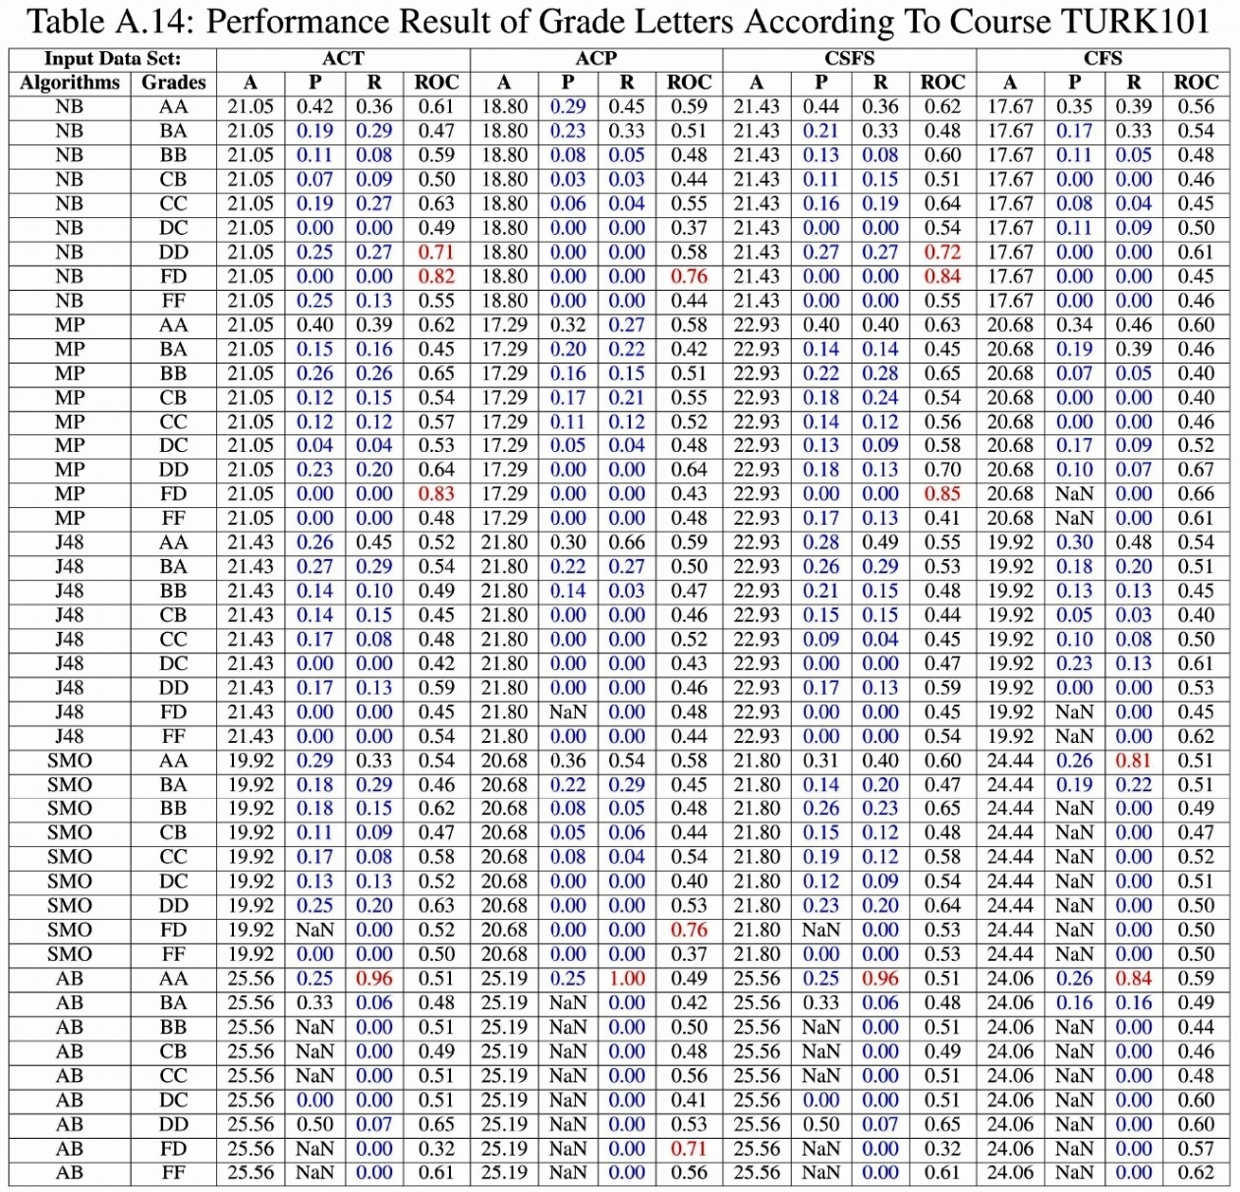
<number>

Slide 87
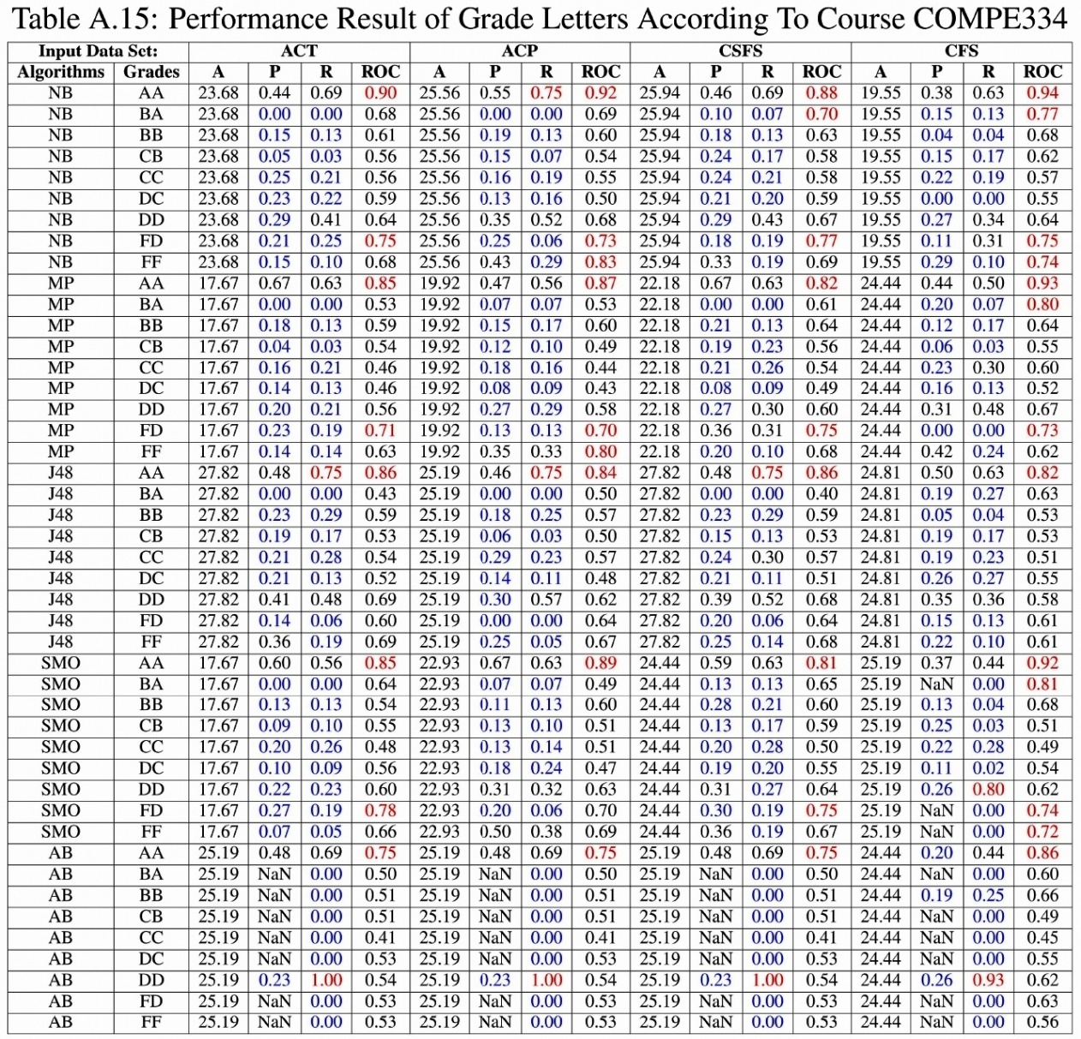
<number>

Slide 88
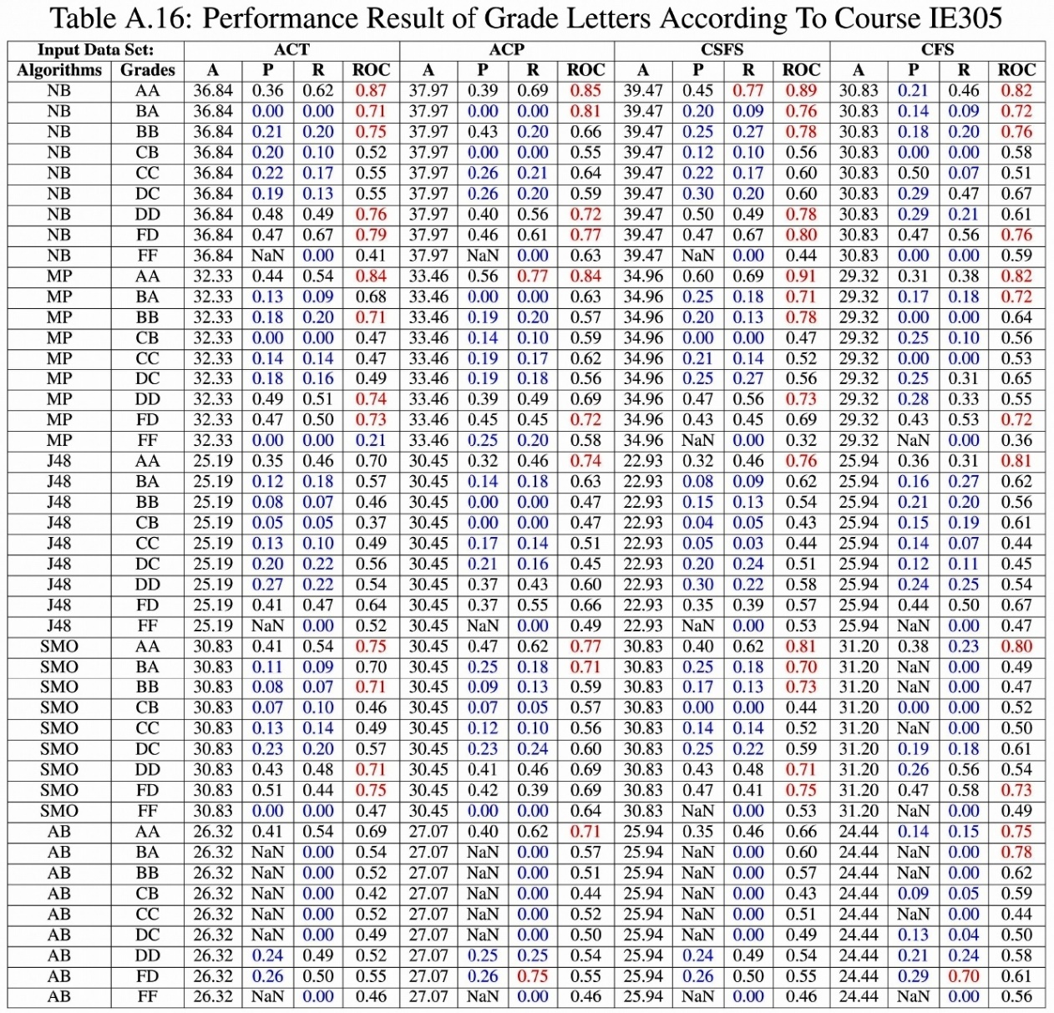
<number>

Slide 89
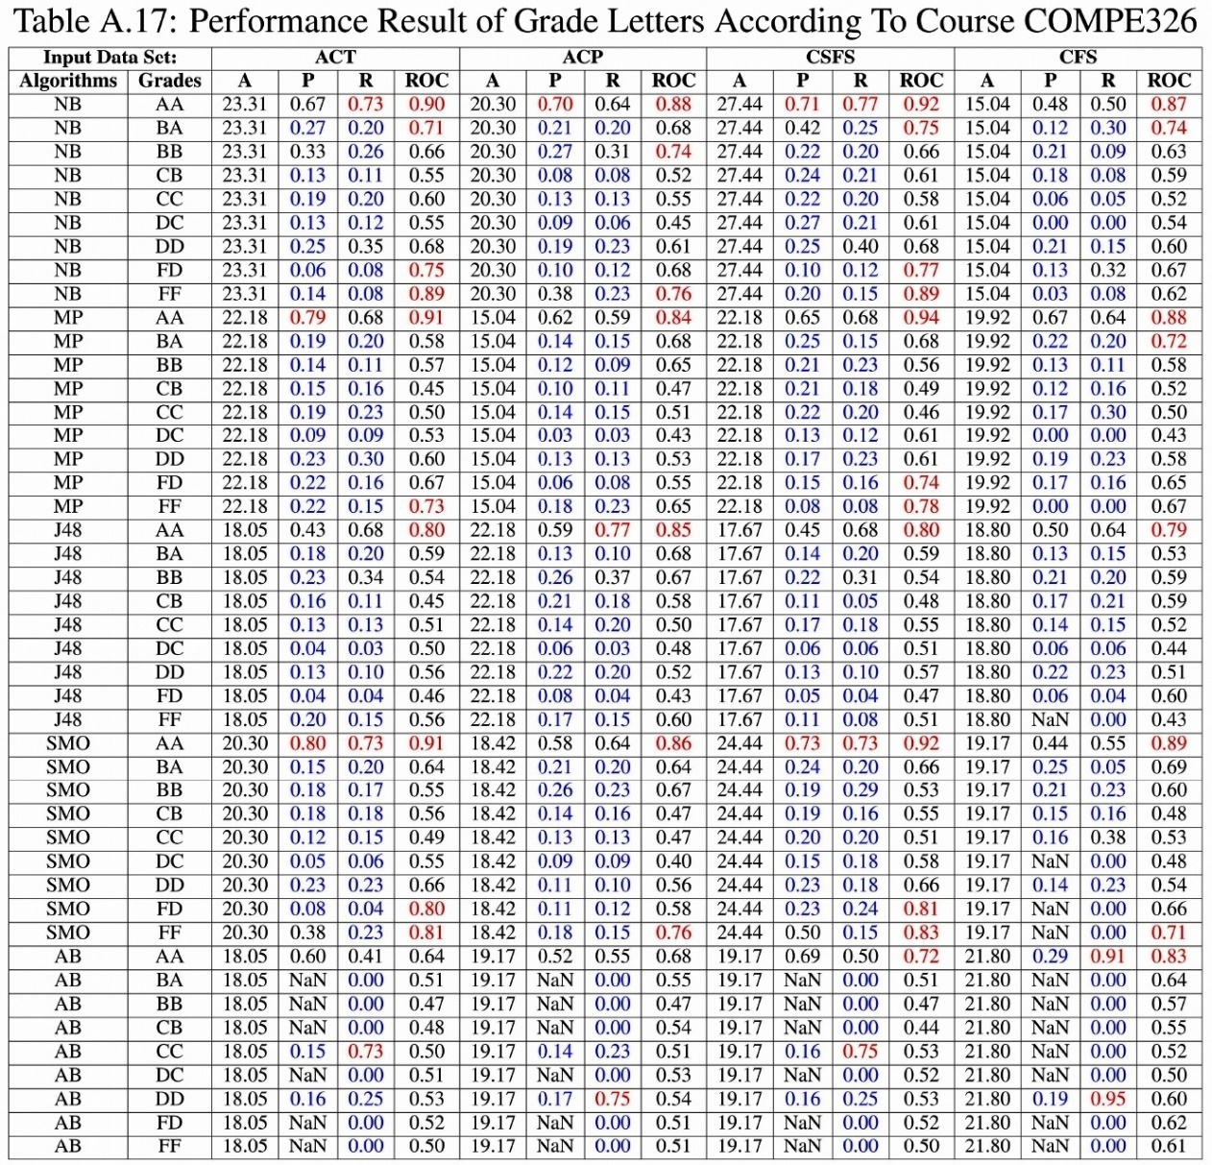
<number>

Slide 90

<number>

Slide 91

<number>

Slide 92

<number>

Slide 93

<number>

Slide 94

<number>

Slide 95

<number>

Slide 96

<number>

Slide 97

<number>

Slide 98

<number>

Slide 99

<number>

Slide 100

<number>

Slide 101

<number>

Slide 102

<number>

Slide 103

<number>

Slide 104

<number>

Slide 105

<number>

Slide 106

<number>

Slide 107

<number>

Slide 108

<number>

Slide 109

<number>

Slide 110

<number>

Slide 111

<number>

Slide 112

<number>

Slide 113

<number>

Slide 114

<number>

Slide 115

<number>

Slide 116

<number>

Slide 117

<number>

Slide 118

<number>

Slide 119

<number>

Slide 120

<number>

Slide 121

<number>

Slide 122

<number>

Slide 123

<number>

Slide 124

<number>

Slide 125

<number>

Slide 126

<number>

Slide 127

<number>

Slide 128

<number>

Slide 129

<number>

Slide 130

<number>

